Slide 1

Challenging Topics at GCSE
NCP19-19
Session 2 – Quadratic Relations
Peter Gates

Slide 2
Workshop dates
Thursday 6th February 2020
Thursday 26th March 2020

Slide 3
Rationale for this WG
New topics have appeared within both the Foundation and Higher Tiers, some of which will prove to be challenging – and we now have a better idea of what these topics are.
Some of the ‘original’ content remains challenging.
We need to think about laying the foundations for these topics earlier in pupils’ mathematics education.

Slide 4
National Curriculum
Aims
The national curriculum for mathematics aims to ensure that all pupils:
become fluent ……
reason mathematically …….
can solve problems …….

Slide 5
Fluency
become fluent in the fundamentals of mathematics, including through varied and frequent practice with increasingly complex problems over time, so that pupils develop conceptual understanding and the ability to recall and apply knowledge rapidly and accurately.

Slide 6
Reasoning
reason mathematically by following a line of enquiry, conjecturing relationships and generalisations, and developing an argument, justification or proof using mathematical language.

Slide 7
Problem Solving
can solve problems by applying their mathematics to a variety of routine and non-routine problems with increasing sophistication, including breaking down problems into a series of simpler steps and persevering in seeking solutions.

Slide 8
Topics for NCP Focus
Quadratics
Simultaneous Equations
Trigonometry
Proof (algebraic and geometric)
Bearings and/or Vectors
Ratio and proportional reasoning
Negative Numbers

Slide 9
Challenging Topics?
Metric units (converting, compound)
Bearings
Algebra (factorising & substitution)
Simultaneous equations
Fractions, decimals & percentages
Negative numbers
Geometric reasoning
Quadratics
Linear Simultaneous Equations
Trigonometry
Proof (algebraic and geometric)
Bearings and/or Vectors
Ratio and proportional reasoning
Inequalities

Slide 10
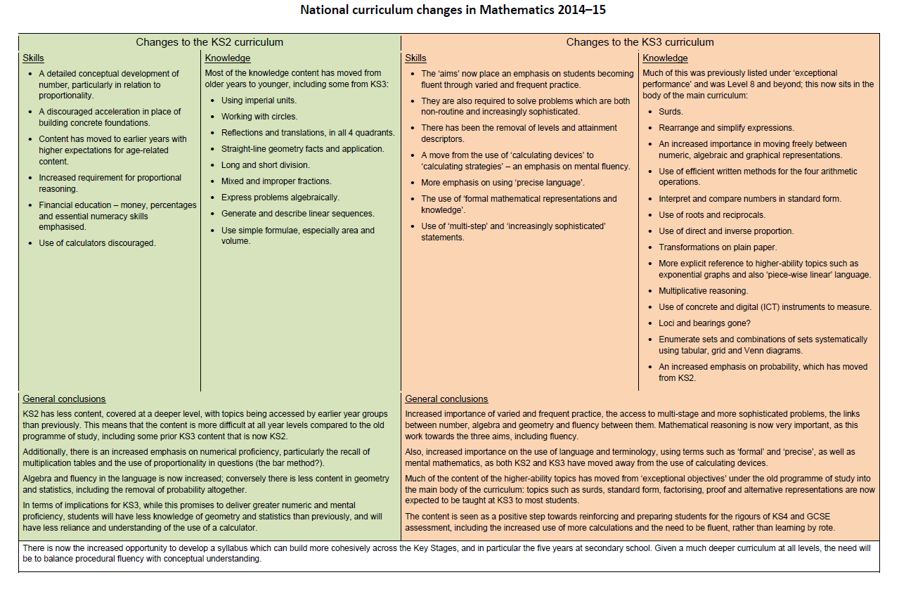
National Curriculum Changes 1

Slide 11
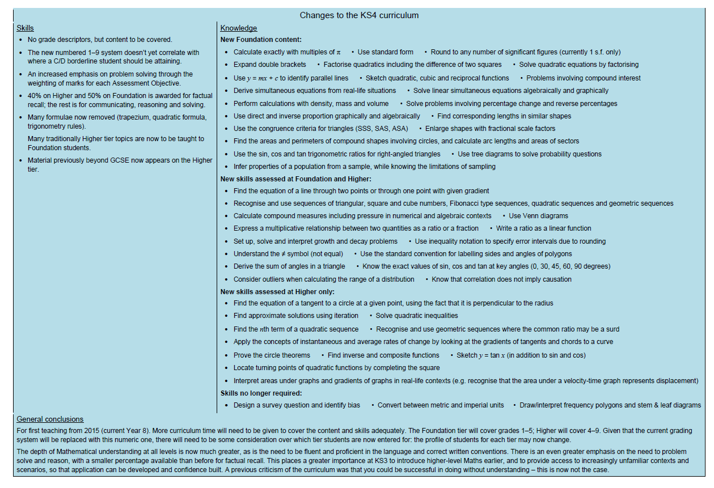
National Curriculum Changes 2

Slide 12
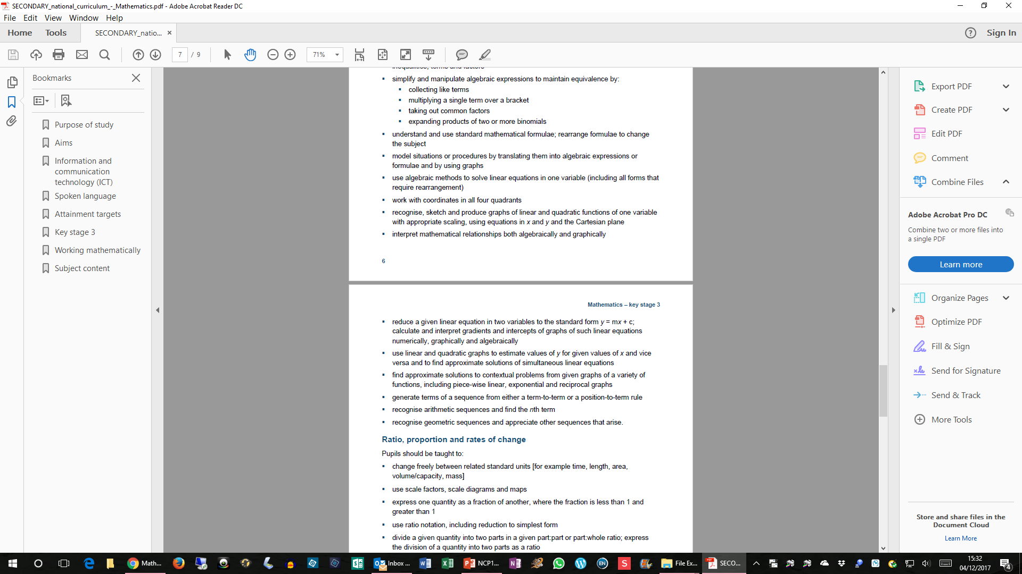
National Curriculum KS3

Slide 13
National Curriculum KS3

Slide 14
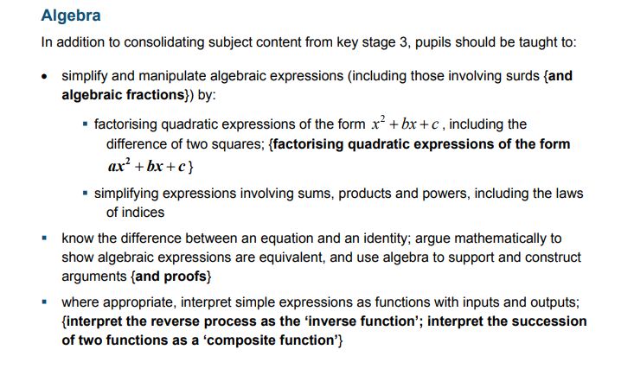
National Curriculum KS4

Slide 15
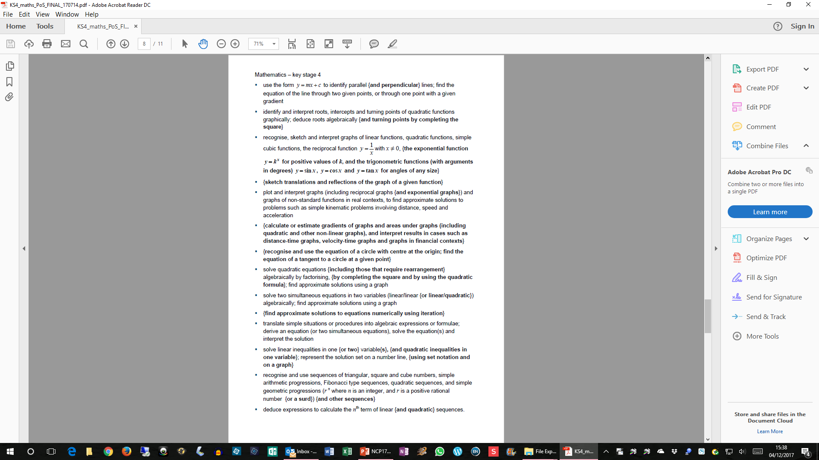
National Curriculum KS4

Slide 16
National Curriculum KS4

Slide 17
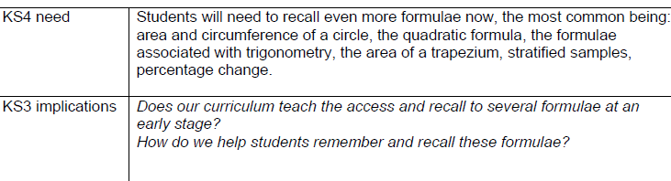
Preparing for the new GCSE 1 - Formulae

Slide 18
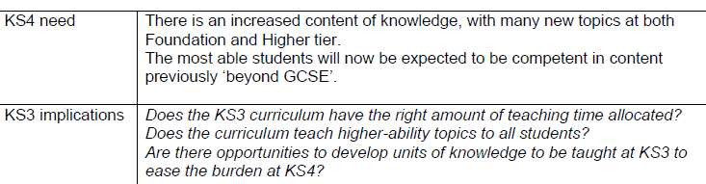
Preparing for the new GCSE 2 – More Content

Slide 19
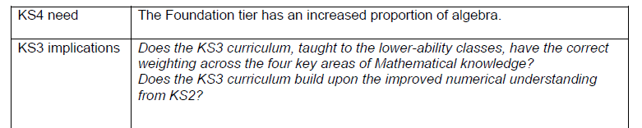
Preparing for the new GCSE 3 – More Algebra

Slide 20
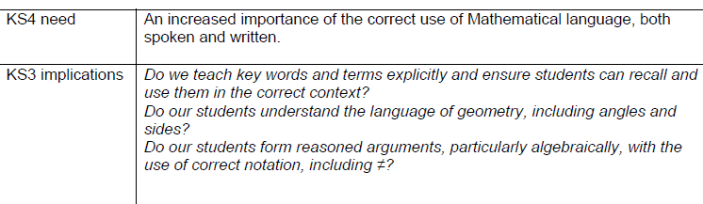
Preparing for the new GCSE 4 – Correct Language

Slide 21
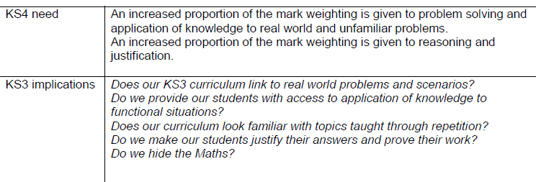
Preparing for the new GCSE 5 – Problem Solving

Slide 22
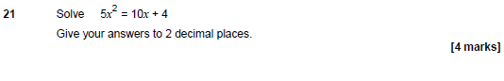
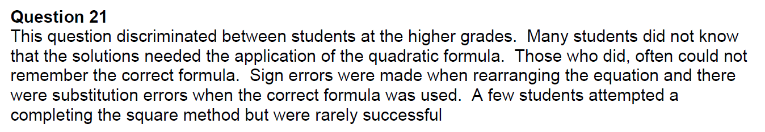

Slide 23
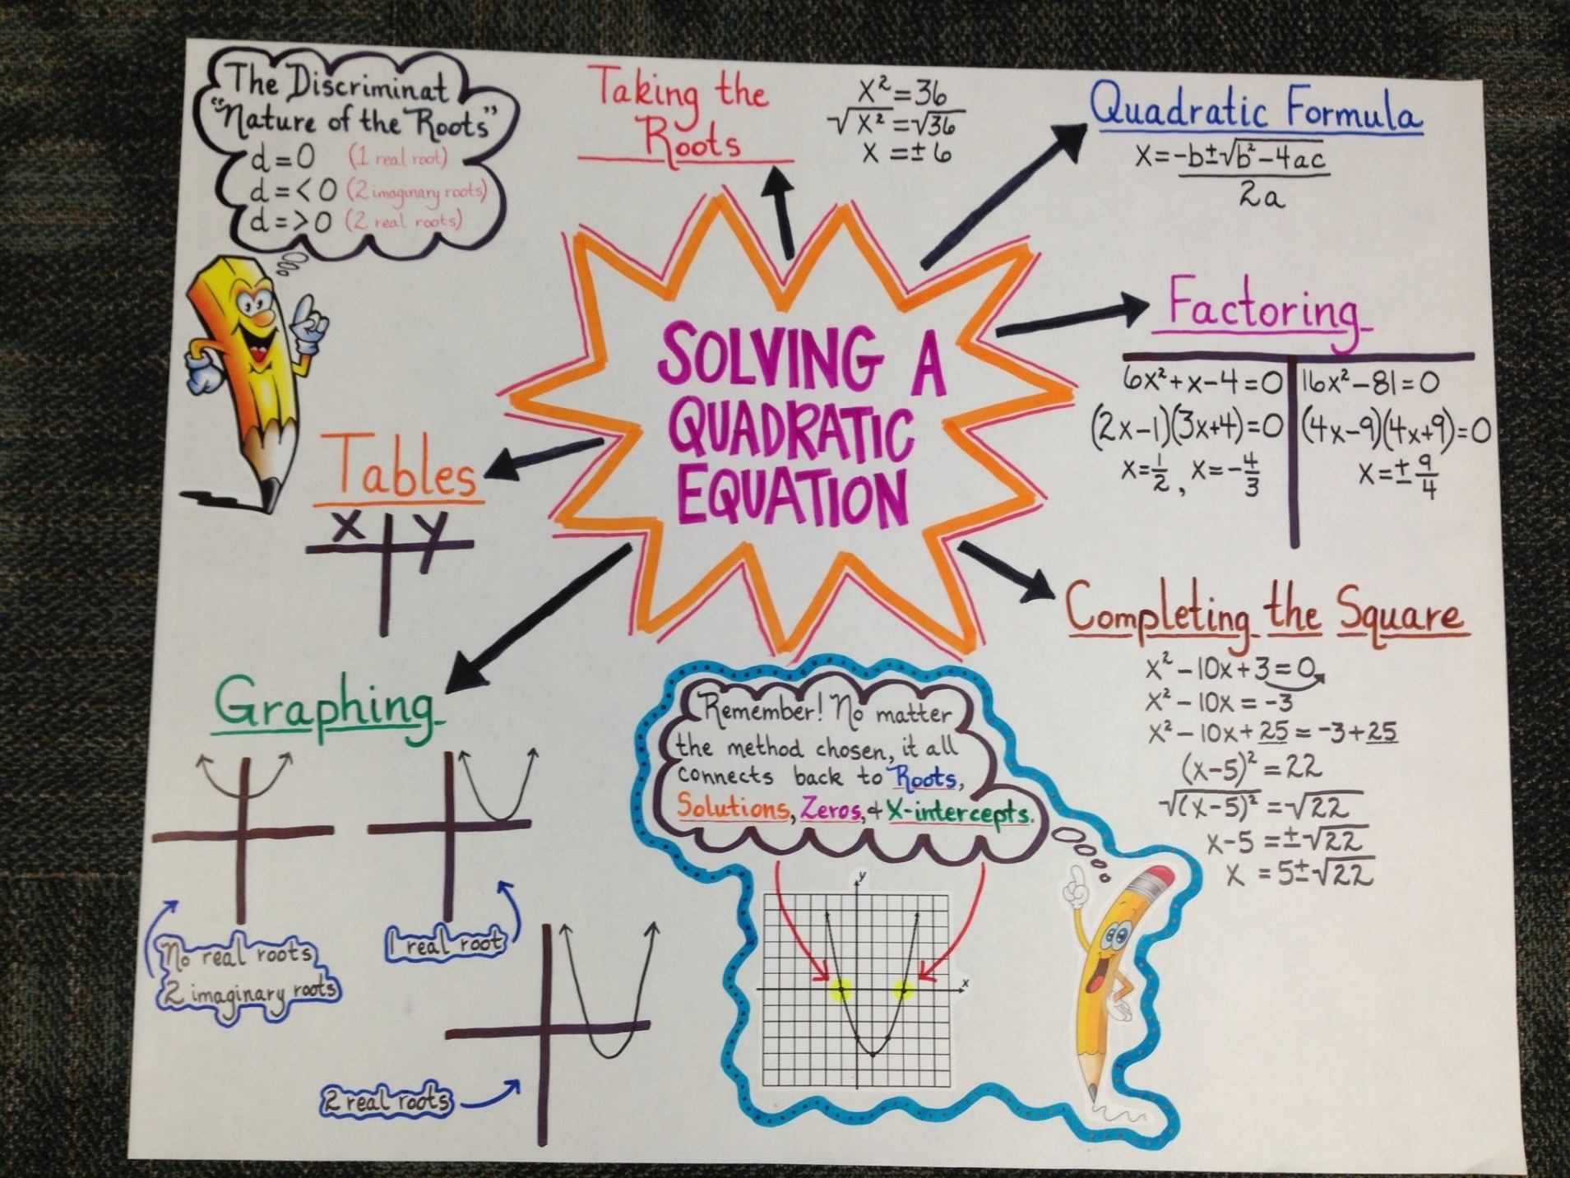

Slide 24
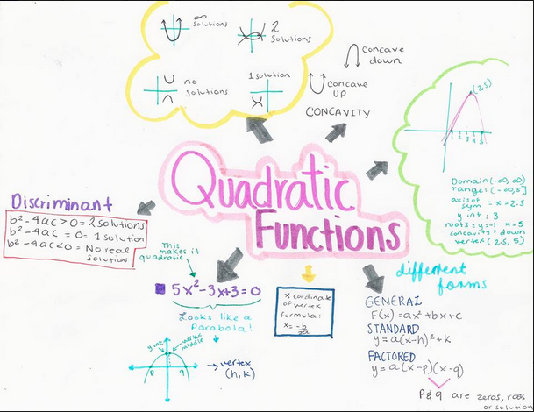

Slide 25
Topic Map
What are the fundamental “blocks” of ideas?
How do these connect together?
What are the pre-requisites?
Are there any logical orderings?
Try to build up a complex web of concepts and techniques.

Slide 26
“Preparing a Topic” framework
What do we need to know?
Key mathematics
What are the key mathematical “big” ideas in the topic
Misconceptions and errors
What common errors do pupils make in this topic and why?
Language and vocabulary
What sort of language and technical vocabulary is used
Techniques and methods
What sort of things do you do in this topic
Topic
Imagery and visualisation
What images, pictures, diagrams are involved?
Contexts and settings
Where is this topic used? What sorts of questions?
What do we now know?

Slide 27
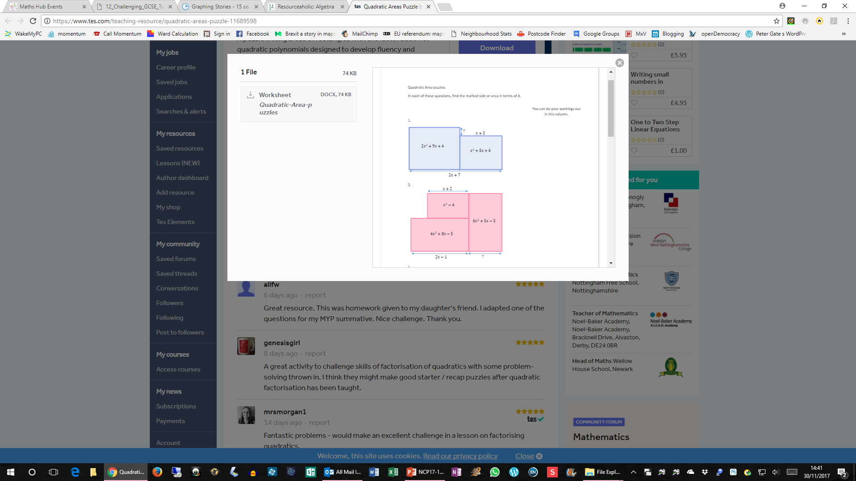
Quadratic Area Puzzles
In each question find the marked side or area in terms of x

Slide 28
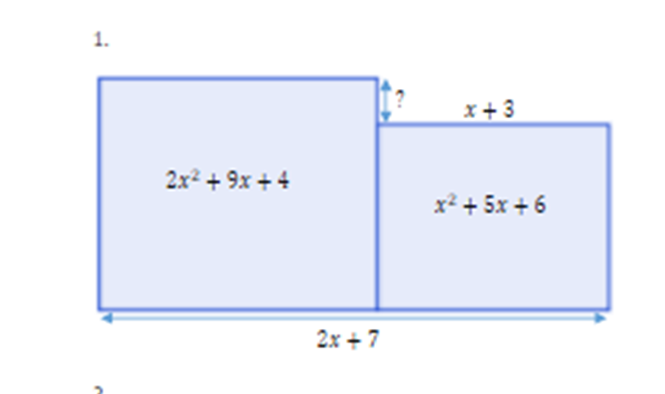

Slide 30
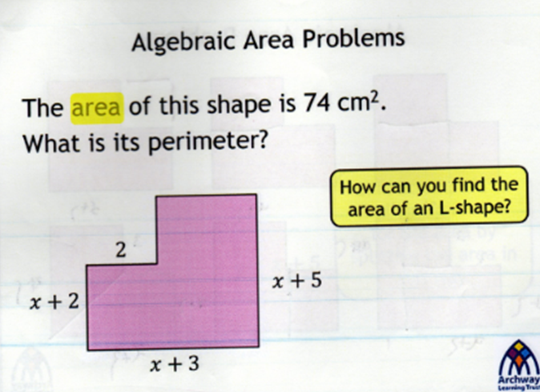

Slide 31
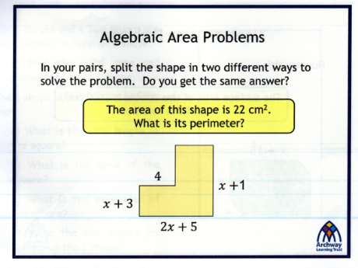
How is this different?
How might we develop this?

Slide 32
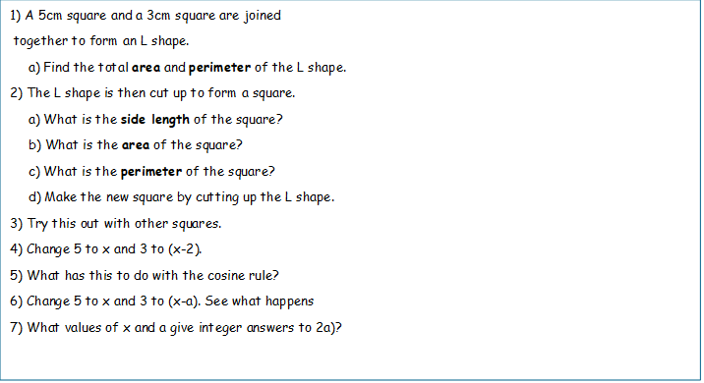
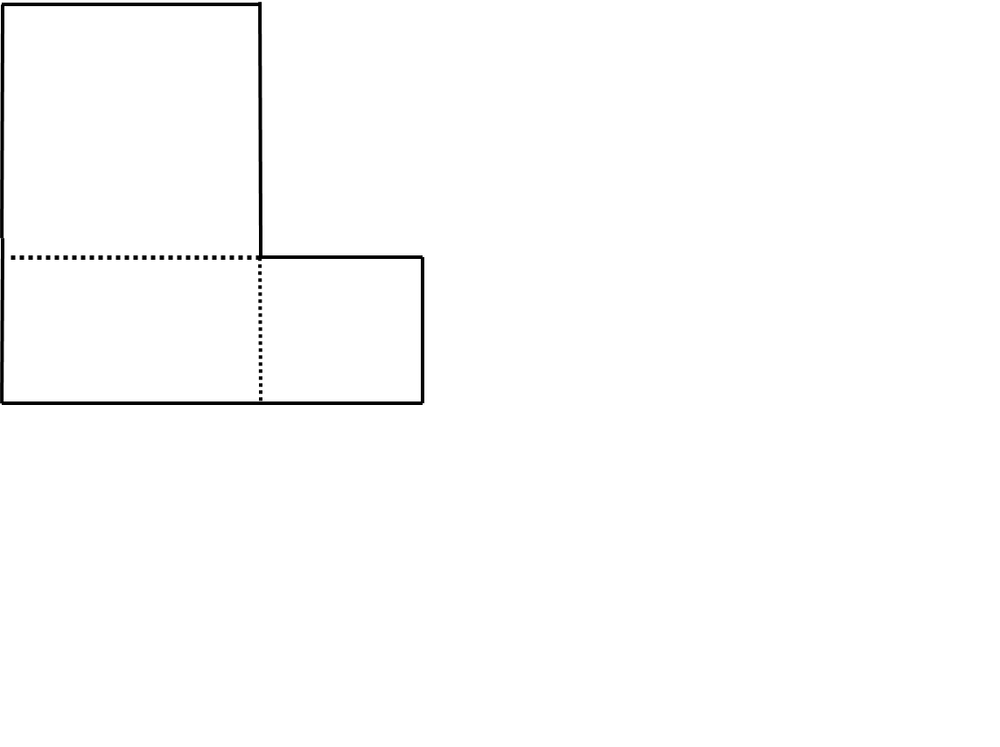

Slide 33
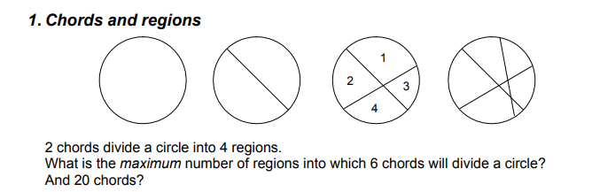

Slide 34


Slide 35
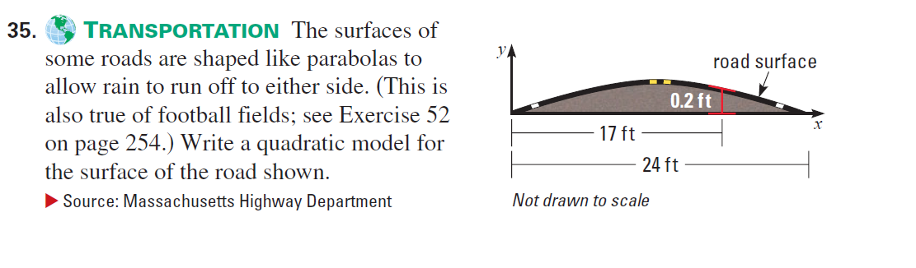

Slide 36
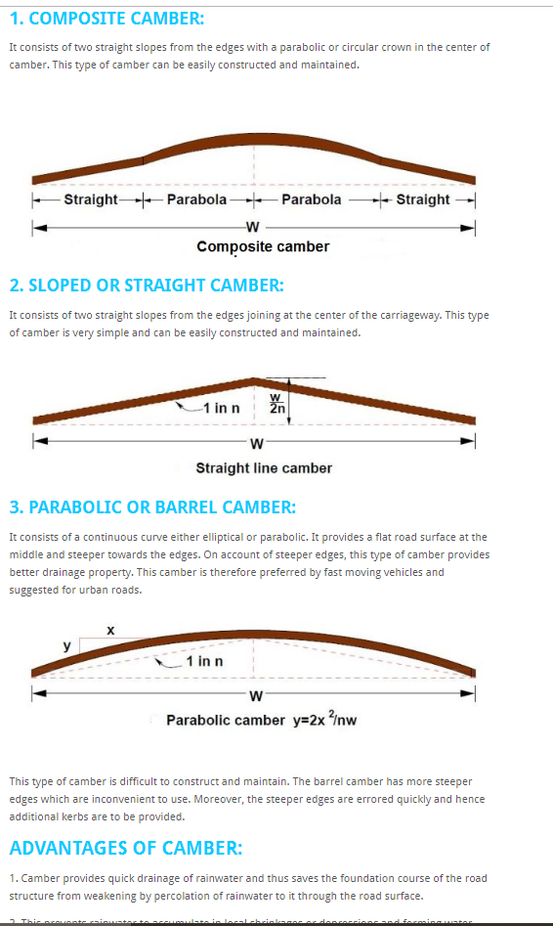
http://dailycivil.com/types-road-camber-advantages-methods-providing-camber/
Single carriageway with two lanes (one in either direction): 5.5m to 7.3m, depending on the traffic and number of access points on the road (like driveways). If it’s a bus route the minimum is 6m (residential street) or 6.75m or 6.9m for other routes depending on the bus. Standard residential streets can be as narrow as 5.5m, as can be rural roads.
Road cambers are usually calculated at around 3 cm of road surface elevation per 30 cm of road width. Whilst essential for maintaining road condition and safety for motorists, it does represent a challenge for learner drivers on the driving test.
https://www.drivingtesttips.biz/road-camber.html

Slide 37
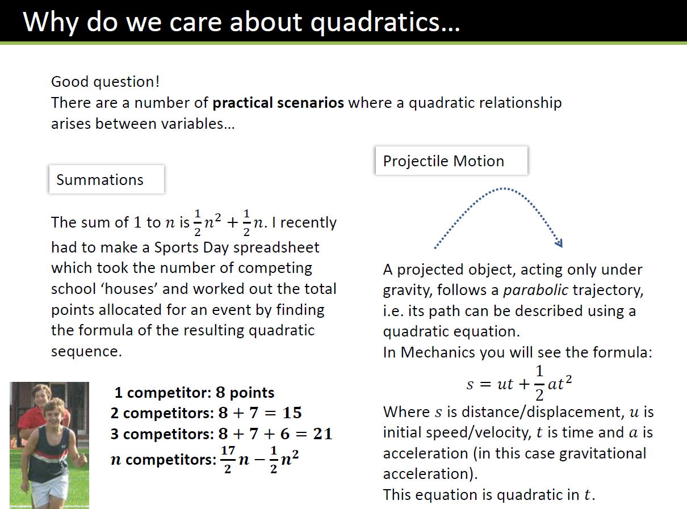
From Dr Frost:
https://www.drfrostmaths.com

Slide 38


Slide 39


Slide 40
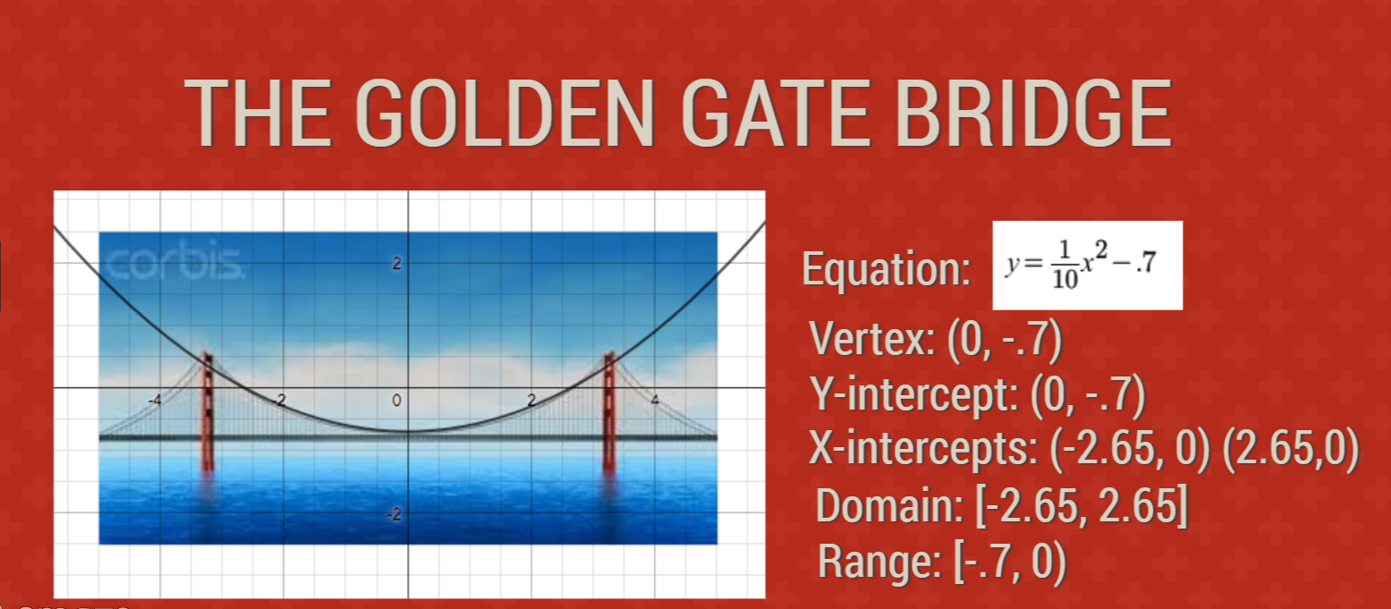

Slide 41
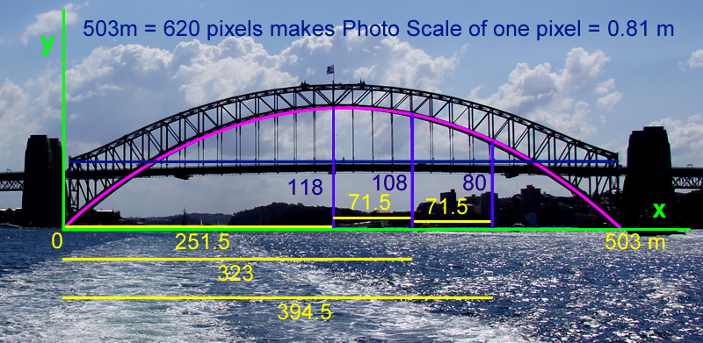

Slide 42
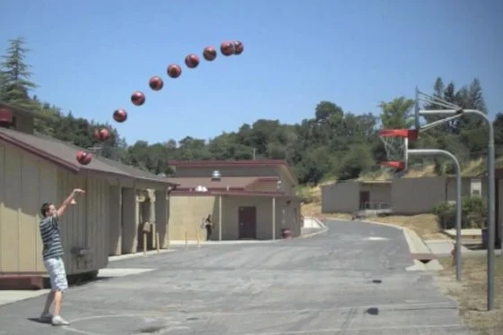

Slide 43
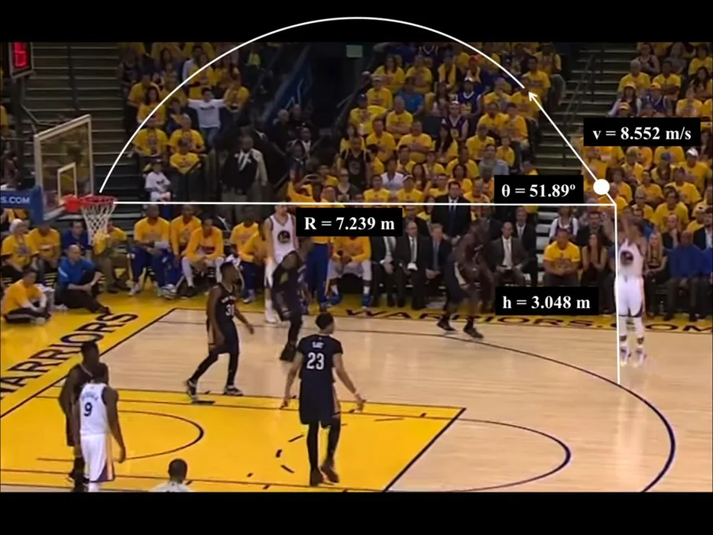

Slide 44
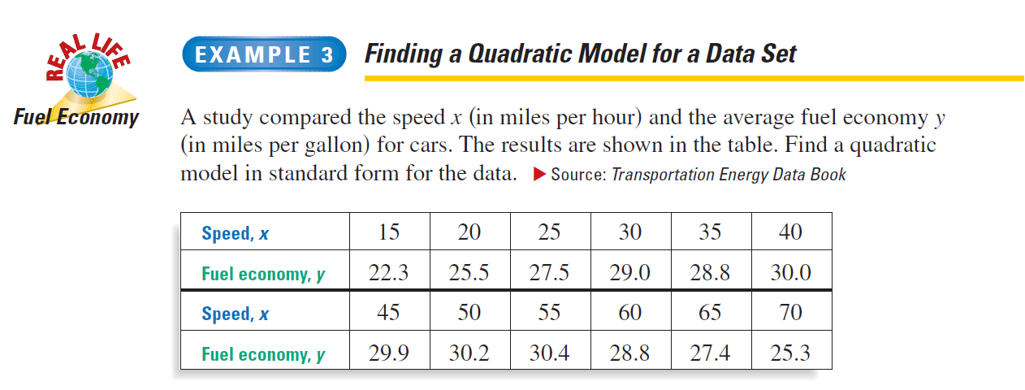

Slide 45
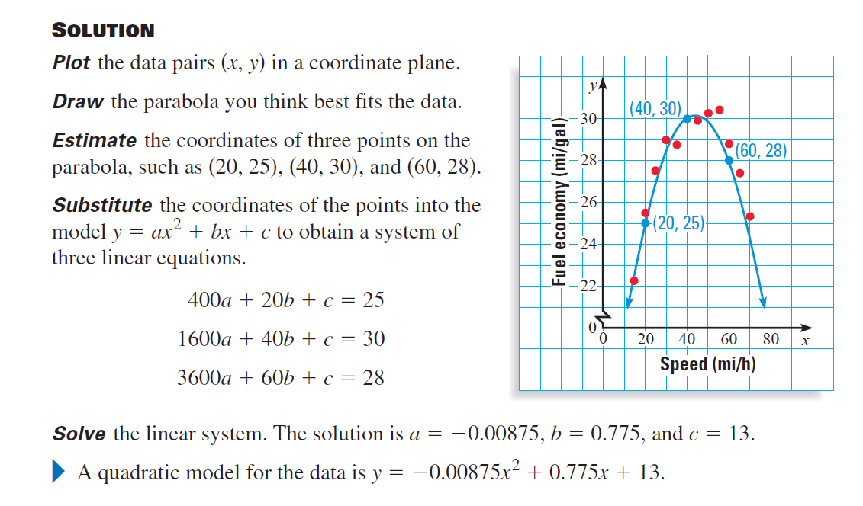

Slide 46
Can you explain …
(x + 3) (x + 2)
(x + 3) (x – 2)
(x – 3) (x – 2)
Can you use diagrams (Algebra Tiles)

Slide 47
Quadratic sequences
1. What is the nth term of the sequence 4, 13, 28, 49,…
2. It is suspected two of these number in this sequence are one out…. 3,12, 30, 55, 87,…
Notes:
3n² +1
2. Sequence is 32, 12, 29, 54, 87
4n² -3n +2

Slide 48
From linear to quadratic
Plot y₁=x+3
Plot y₂=x-2
Plot y₁₊y₂
Plot y₁₋y₂
Plot y_{1x}y₂
Plot y_{1/}y₂
Vary y₁ and y_{2.} What do you notice?

Slide 49
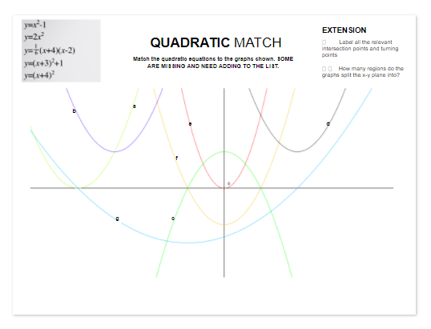

Slide 50
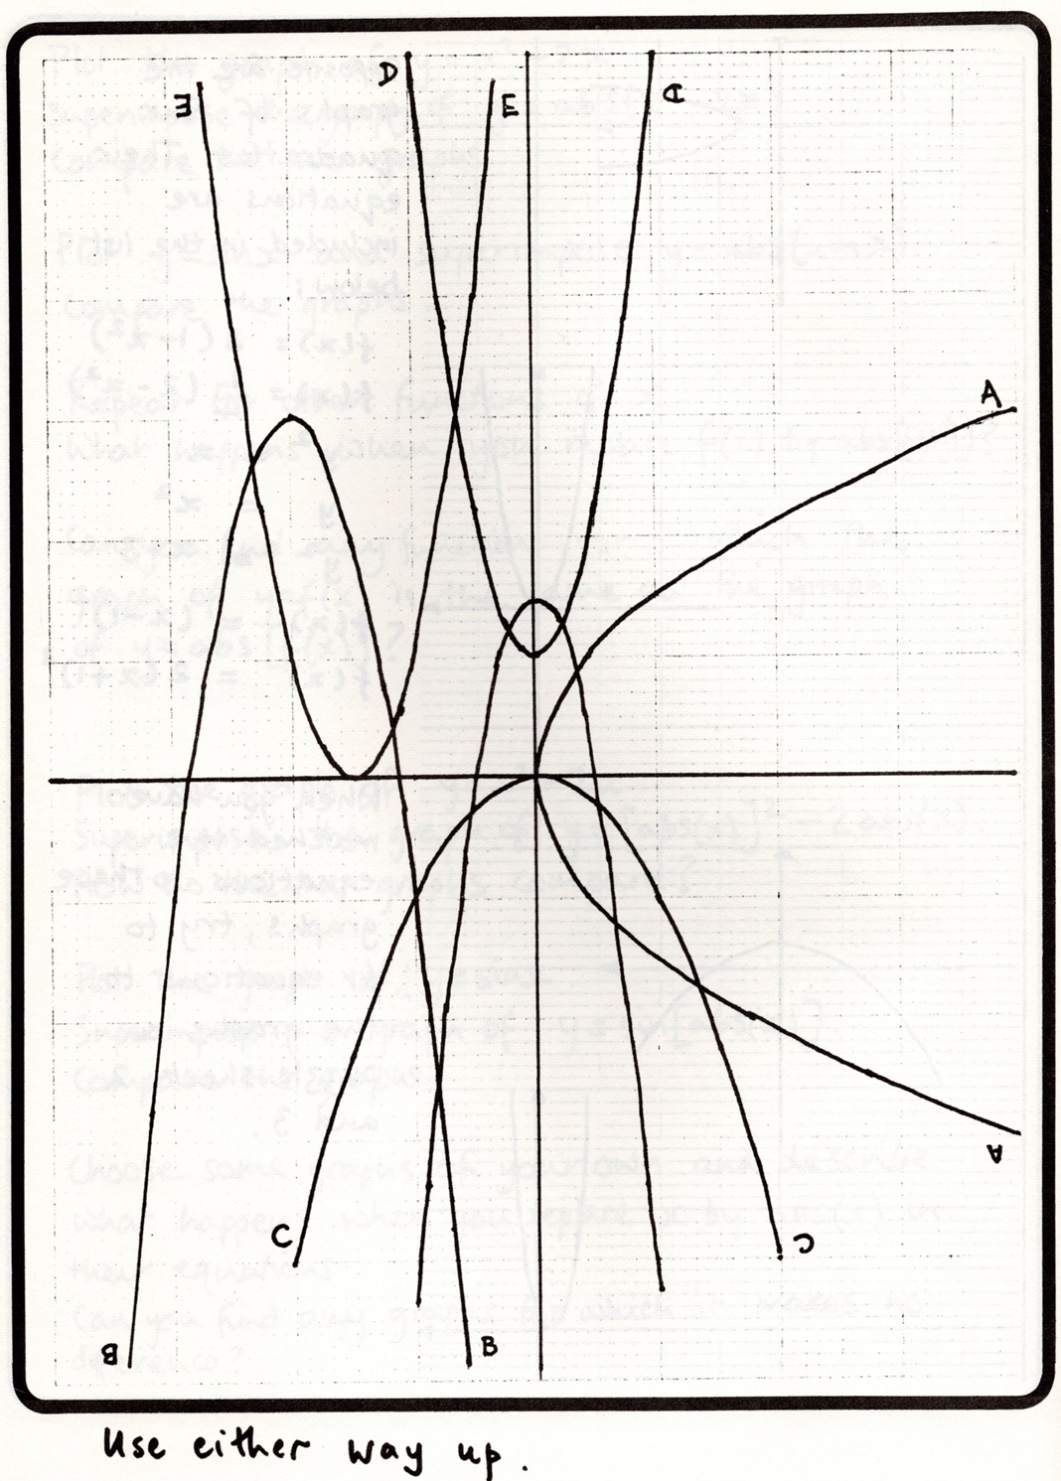

Slide 51
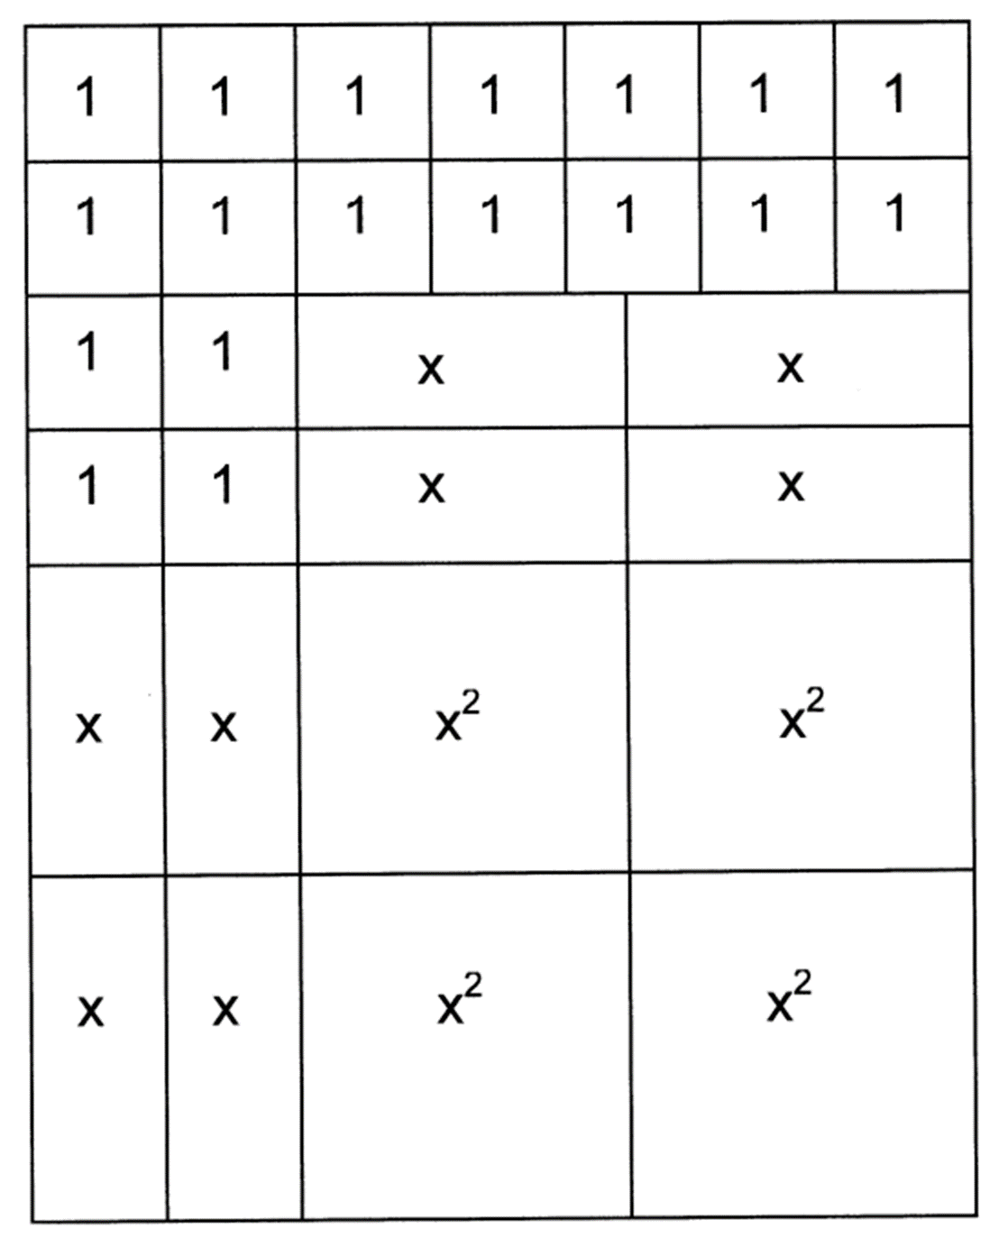
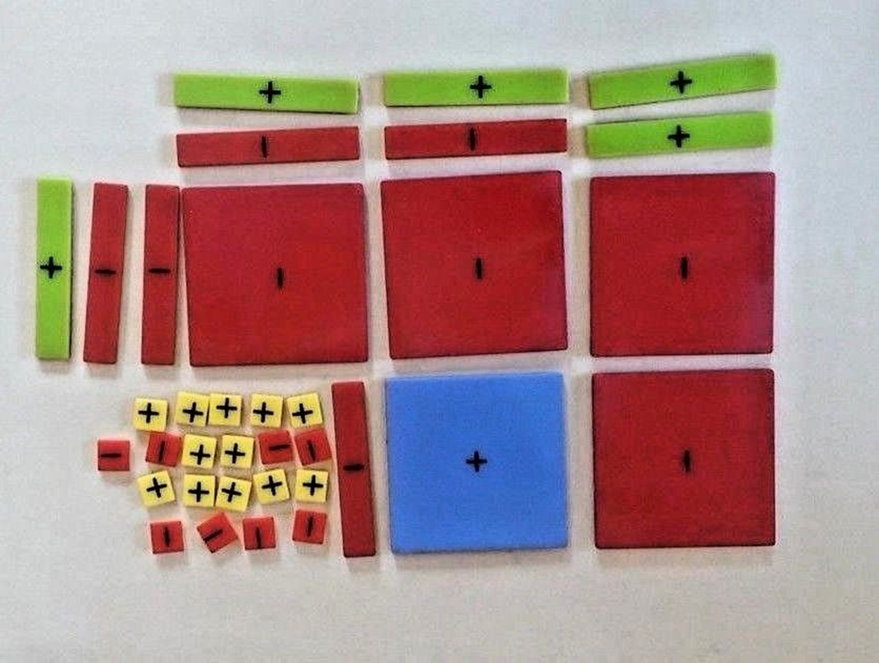
Algebra Tiles

Slide 52

Some interesting Resources?
Graphing Stories
http://www.graphingstories.com/
Resourceaholic
http://www.resourceaholic.com/p/resource-library-key-stage-34-algebra.html#Area
Graphing
https://www.desmos.com/calculator

Slide 53
GCSE Questions in Quadratics
AQA Higher Paper 1 2017

Slide 54
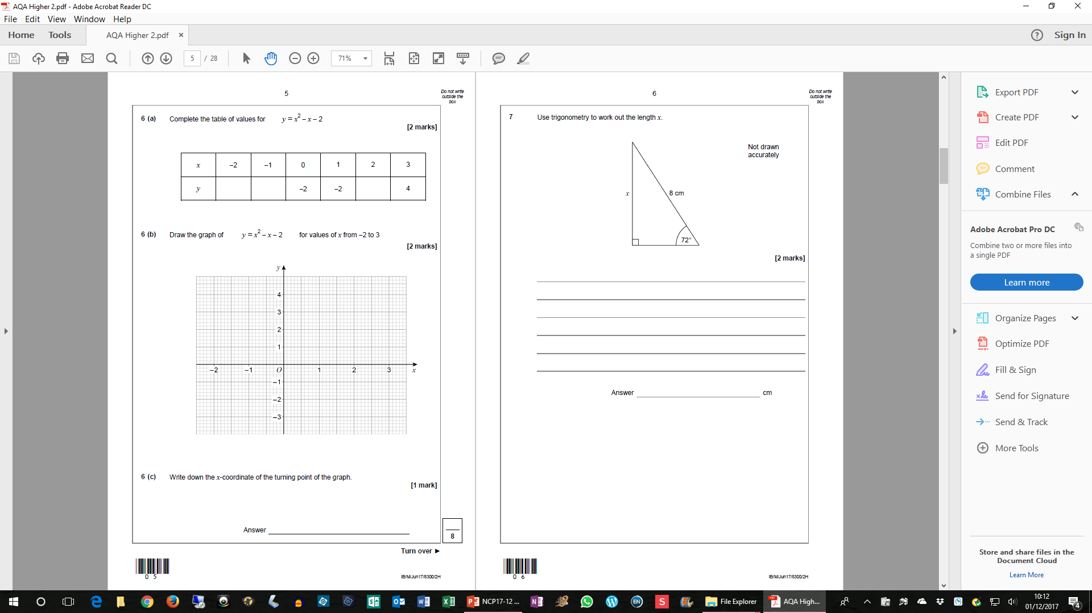
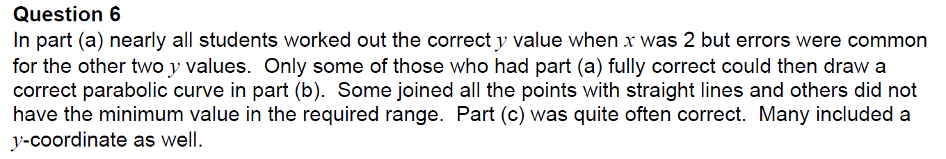
AQA Higher Paper 2 2017

Slide 55
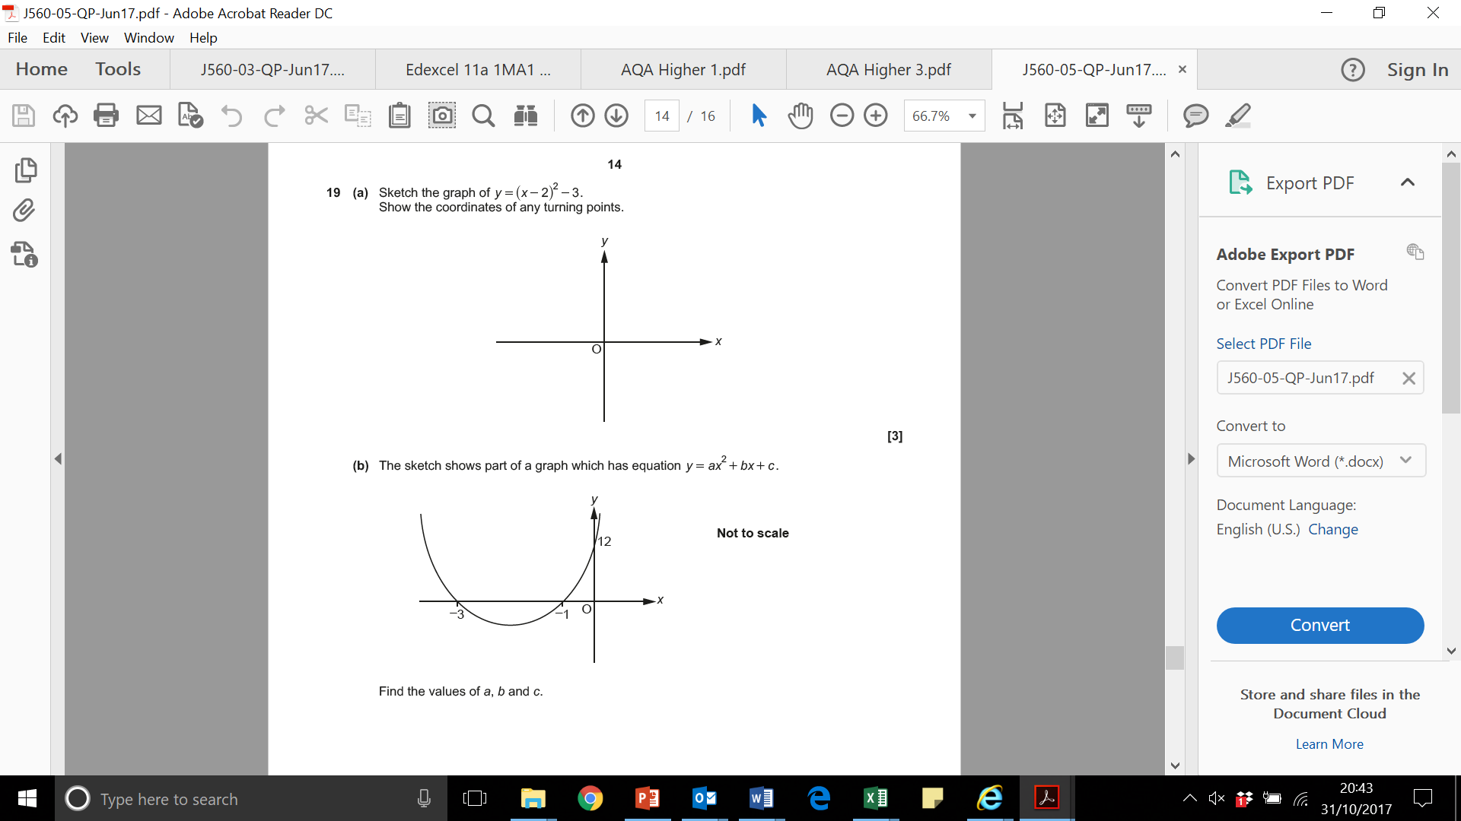
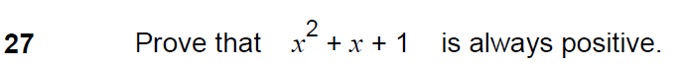
Three more…

Slide 56
Sites for quadratics
https://www.mathsisfun.com/algebra/quadratic-equation-real-world.html
https://sciencing.com/everyday-examples-situations-apply-quadratic-equations-10200.html
http://www.montereyinstitute.org/courses/Algebra1/COURSE_TEXT_RESOURCE/U10_L2_T1_text_container.html
https://www.ck12.org/book/CK-12-Algebra-I-Concepts-Honors/section/9.4/
https://study.com/academy/lesson/using-quadratic-formulas-in-real-life-situations.html
https://www.smore.com/2kjqr-quadratic-relationships

Slide 57
The power of technology
Since all pupils now have access to extremely powerful technology, get them to install Desmos on their phones, to use in lessons ….

