Slide 1
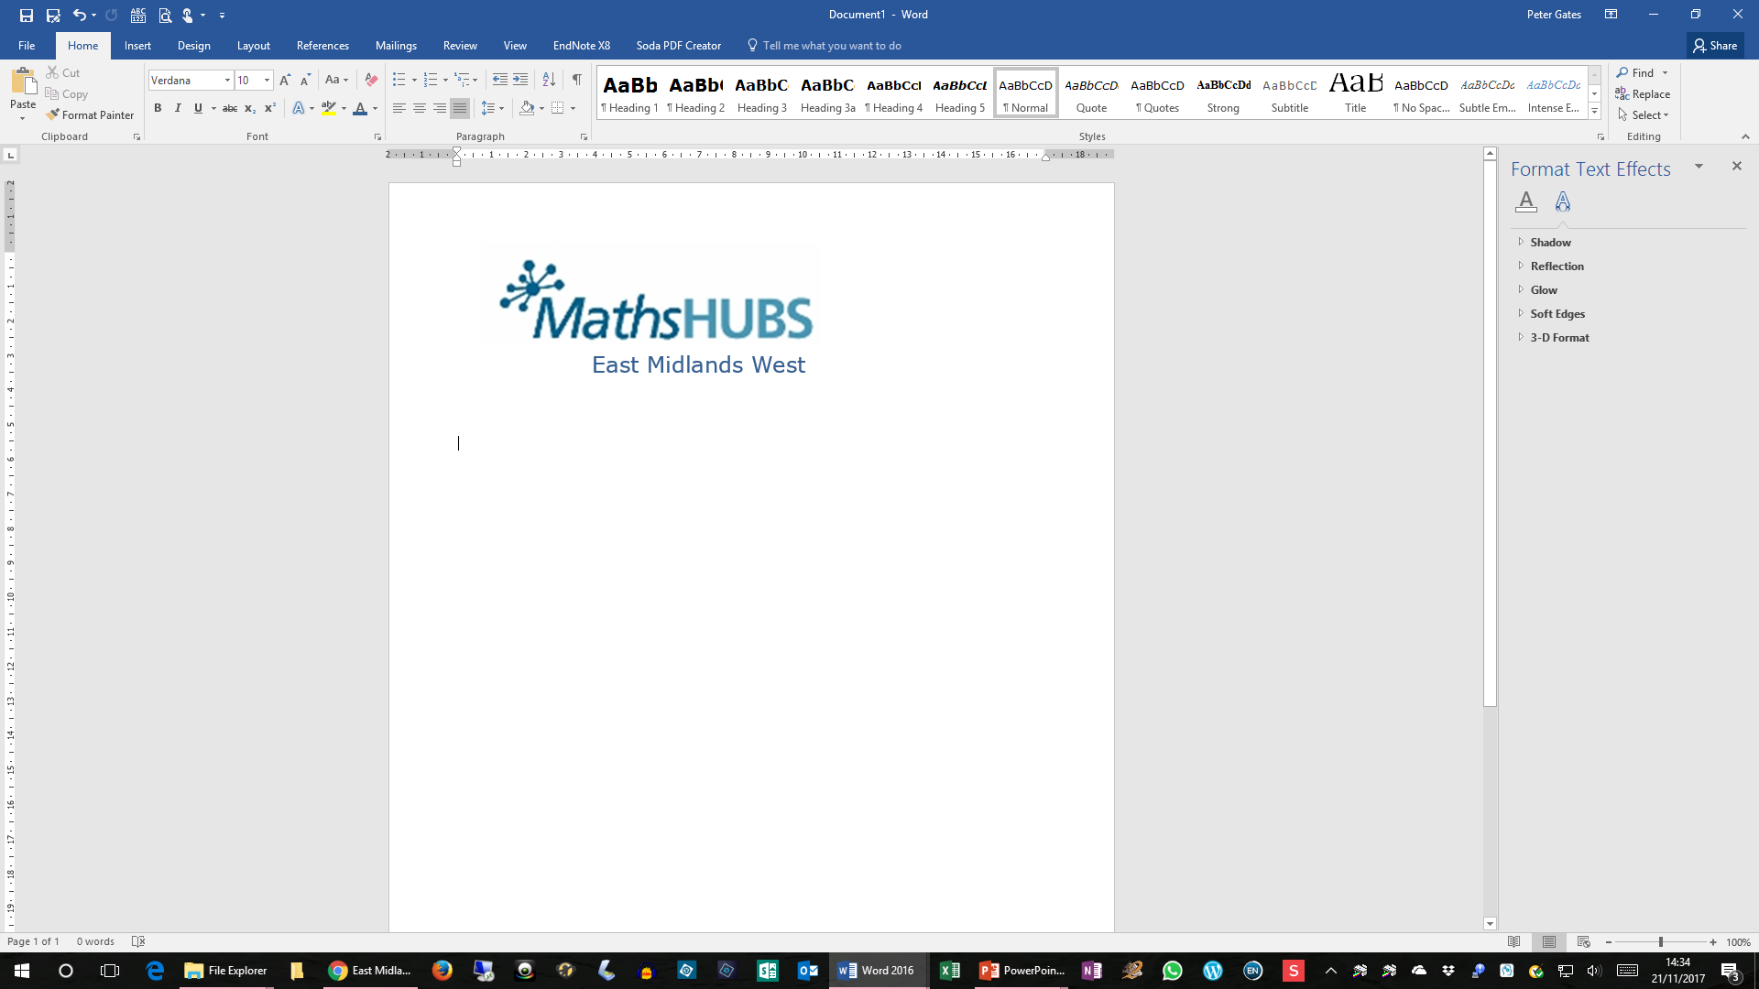
Challenging Topics at GCSE
NCP19-19
Session 1
Peter Gates

Slide 2
Rationale for this WG
New topics have appeared within both the Foundation and Higher Tiers, some of which will prove to be challenging – and we now have a better idea of what these topics are.
Some of the ‘original’ content remains challenging.
We need to think about laying the foundations for these topics earlier in pupils’ mathematics education.

Slide 3
Why are we here?
This Work Group offers teachers and their departments nationally coordinated support to gather evidence from teachers’ early experiences with the new maths GCSE, with particular emphasis on how a new mix of challenging topics (for students and teachers) has emerged.
Informed by this experience, Work Groups will develop new, or re-shaped, teaching approaches that match the new challenges and that, once embedded, will help students succeed, at both Higher and Foundation level.
The Work Group will largely consist of pairs of teachers from up to half a dozen secondary schools. Ideally each pair will comprise one teacher with a curriculum responsibility within their department and one other teacher, perhaps a non-specialist.

Slide 4
What is involved?
The Work Group will meet roughly half-termly throughout the year.
Participants will focus on one or more challenging topics.
Work Groups will develop and share teaching activities and approaches designed to have immediate impact with KS4 students.
Work Groups will also develop and share teaching activities for KS3 students which better prepare them for the chosen topic.
Participants will evaluate the success of the activities and approaches.

Slide 5
Intended Outcomes
Participant teachers develop deeper understanding of why certain topics are challenging (for both students and teachers) including factors associated with student experiences in KS3.
Maths departments in participant schools, through collaboration and experimentation, develop new and shared ways of preparing for, and teaching, challenging topics.
Pupils become more confident in their own skills and abilities, developing a deeper and more connected understanding of prior content thus enabling them to better tackle the challenging topics.

Slide 6
The wider context
The changes to GCSE Mathematics, with new and deeper content moving into both Higher and Foundation areas, have created challenges for both students and teachers. At both tiers, teachers have found themselves teaching ‘new’ topics, and perhaps topics that challenge their own subject knowledge.
At the same time, at both tiers, students have been confronted by topics that, based on their prior attainment, have stretched them significantly. To address this changed landscape, it is helpful to stand back, take stock from the first two years experience of teaching and exam-sitting, and explore ways to adjust teaching approaches to maximise the chances of future cohorts of KS4 students being taught these new topic areas more effectively.
A fruitful way of doing this is for teachers from different schools to compare notes, share current and previous experiences, and collaborate to develop effective models both of individual teacher professional development and of departmental working.

Slide 7
Expectations of participants and their schools
Participating teachers will be expected to:
Share ideas and activities with others
Reflect critically upon their own teaching approaches
Trial a range of approaches, strategies and activities agreed upon by the Work Group
Maths departments in participating schools will be expected to:
Support the participants by allowing them to trial activities and to disseminate findings at departmental meetings

Slide 8
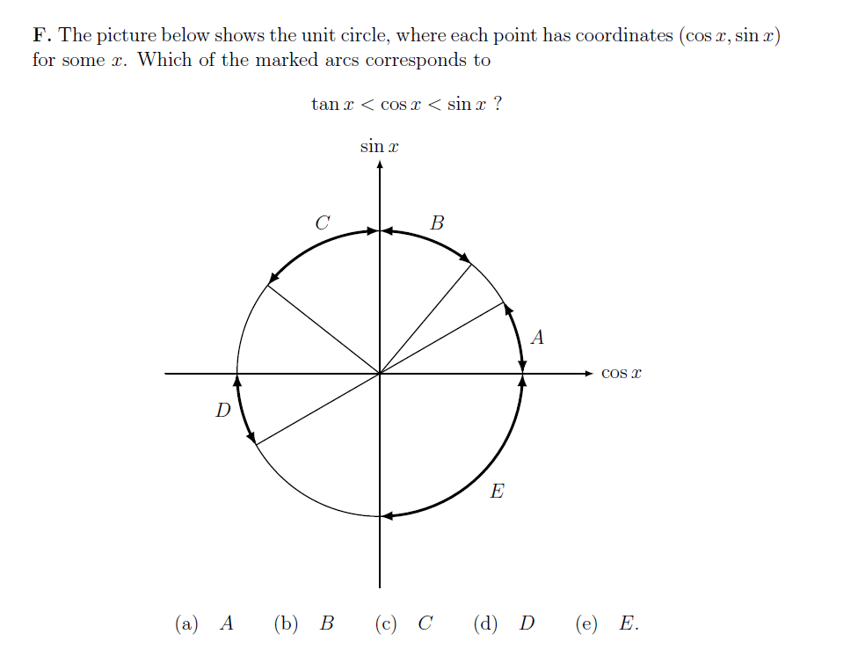

Slide 9
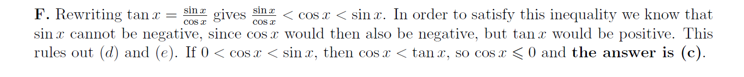

Slide 10
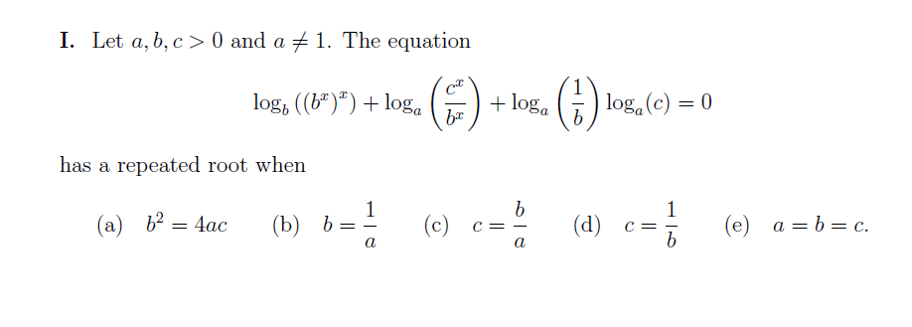

Slide 11
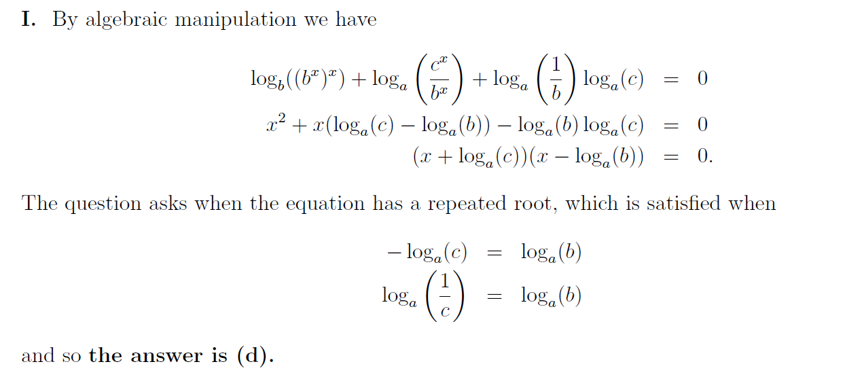

Slide 12
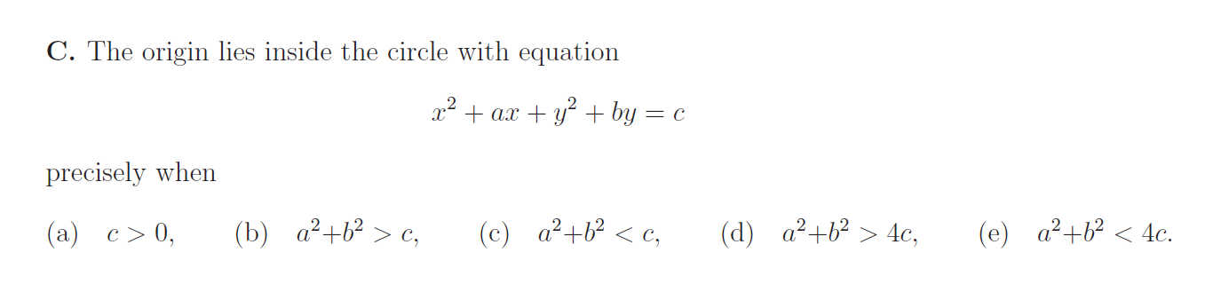

Slide 13
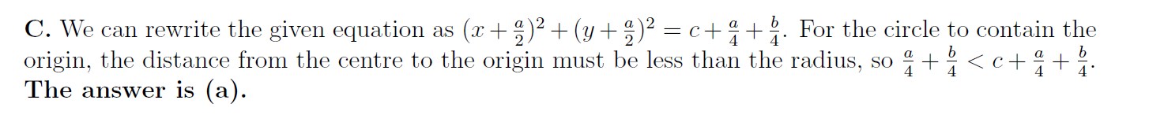

Slide 14
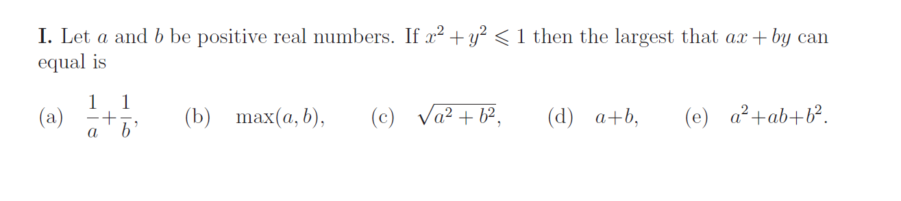

Slide 15
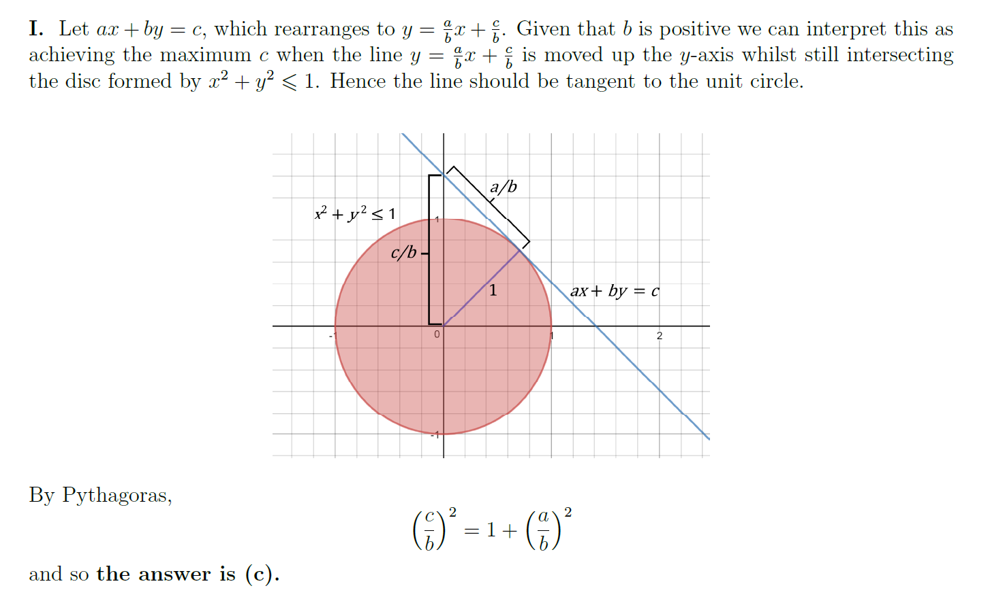

Slide 16
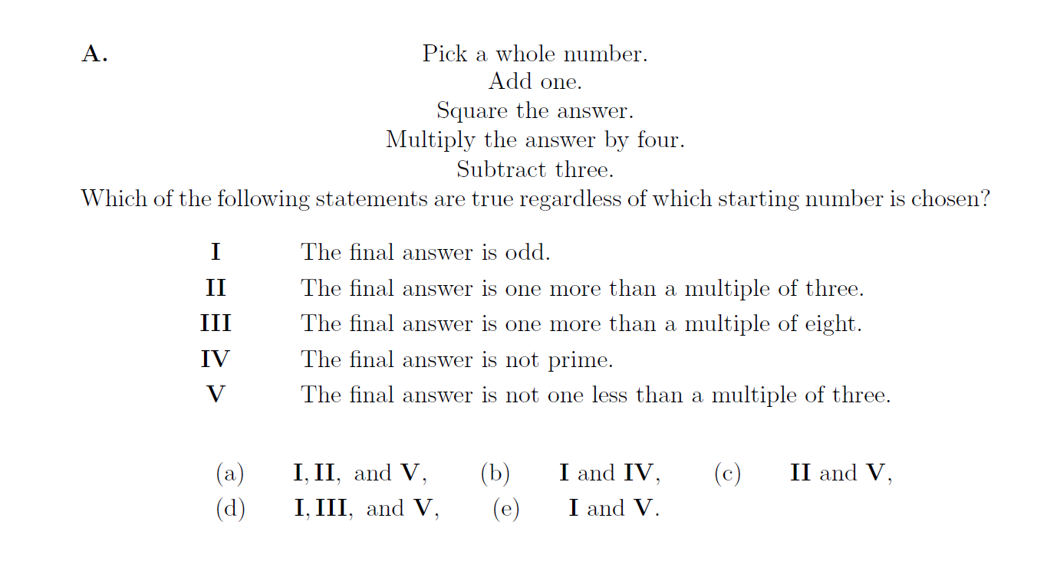

Slide 17
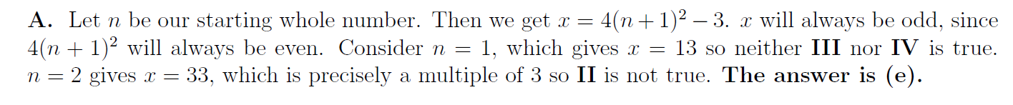

Slide 18
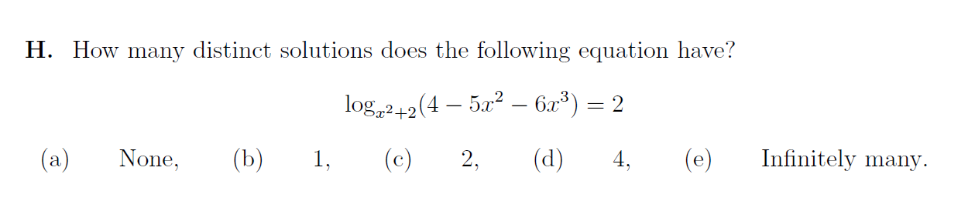

Slide 19
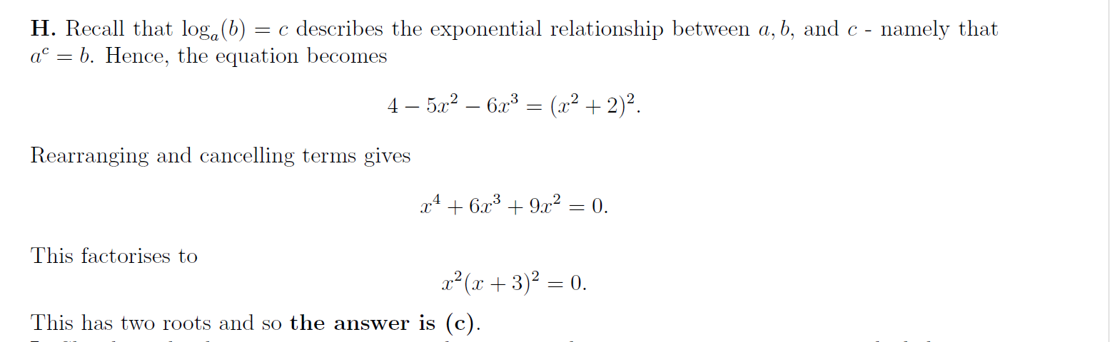

Slide 20
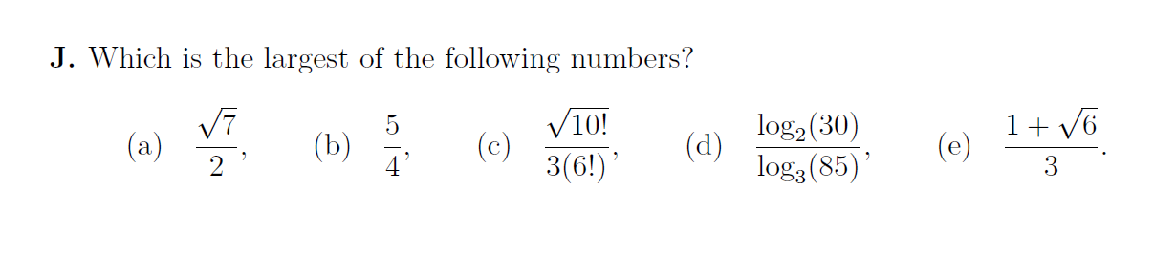

Slide 21
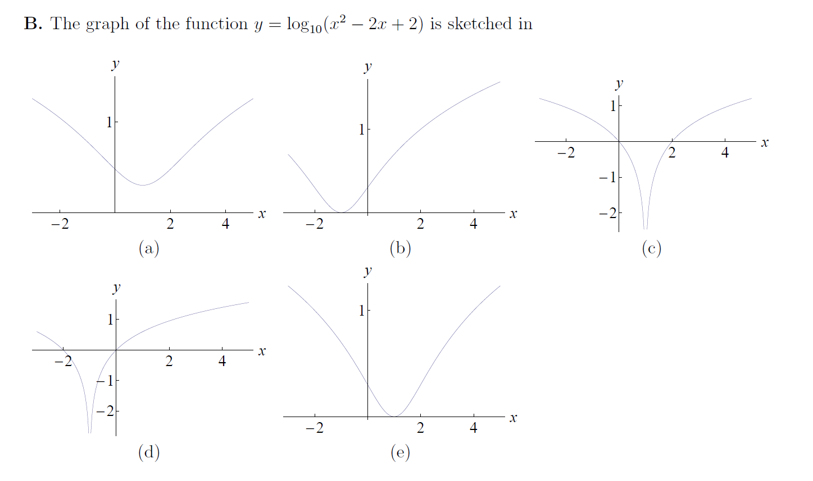

Slide 22
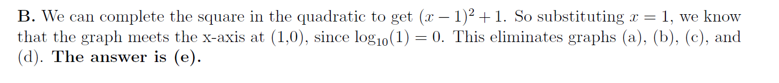

Slide 23
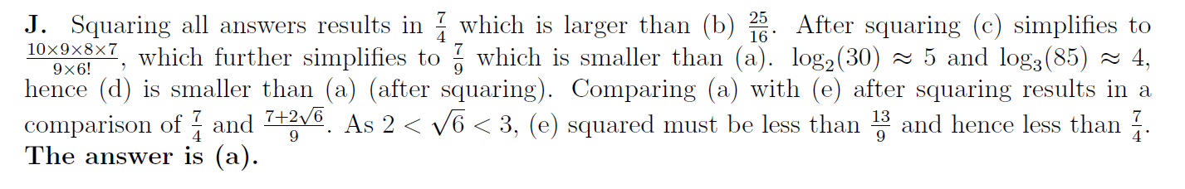

Slide 24
Subject aims and learning outcomes
GCSE specifications in mathematics should enable students to:
develop fluent knowledge, skills and understanding of mathematical methods and concepts
acquire, select and apply mathematical techniques to solve problems
reason mathematically, make deductions and inferences and draw conclusions
comprehend, interpret and communicate mathematical information in a variety of forms appropriate to the information and context.
Notes:
RW

Slide 25
Reasoning and Pupil Background
Children from high SES backgrounds are generally better at mathematical reasoning than their peers
Individual children whose SES status is high are on the whole better at mathematical reasoning than those from lower SES homes, even if they are at the same school. The influence of SES at the individual level is similar to an effective educational intervention: it raises the average level of performance and reduces the variation between children, and consequently the proportion of children who show difficulty in mathematics.
SES also operates at the level of the school. Children, who go to Primary schools in which the SES composition is high, reason about mathematics more successfully than children at schools with a lower SES composition, whatever their own social background.

Slide 26
Reasoning and Pupil Organisation
Ability grouping improves reasoning very slightly in the top ability group, but hinders the progress of children in the other groups.
Setting only improves mathematical achievement of children in the top ability group, but this effect is small. It actually hinders the progress of children in the other groups. It also influences children’s self-confidence in maths: children of the same level of ability placed in a lower ability group are less confident in their ability than those placed in a higher group.
Schools need to consider alternatives to grouping children by ability levels if they want to promote higher achievement for children with all levels of ability.

Slide 27
Topics that challenged ‘Higher’ pupils
Proof
Inequalities
Negative numbers
Units (converting, compound measures)
Ratio and proportion
Geometric reasoning

Slide 28
Topics that challenged ‘Foundation’ pupils
Metric units
Bearings
Algebra (particularly factorising and substitution)
Simultaneous equations
Fractions, decimals and percentages
Ratio and proportion

Slide 29
Topics for NCP Focus
Quadratics
Negative/Directed numbers
Linear Simultaneous Equations
Trigonometry
Proof (algebraic and geometric)
Bearings and/or Vectors
Ratio and proportional reasoning

Slide 30
Plan for the Workgroup
During the year we work on what makes these topics “challenging”
We explore frameworks for preparing to teach a topic
We explore a conceptual map/structure for topics
We look for big ideas, misconceptions, connections
We search out existing resources
We consider whether we produce a resource for teachers or pupils

Slide 31
Knowledge of the next/previous PoS
Over time, teachers become familiar with the mathematics for the year group or key stages that they teach.
Teachers are often less familiar with the preceding or succeeding programmes of study or exam specifications.
Understanding how a topic:
  builds on earlier learning
  develops beyond the current year/key stage
  helps to inform teaching approaches that equip pupils best, including for future learning.
This is all about progression and connection-making:
  from one unit of work/topic/lesson to the next
  within lessons.

Slide 32
National Curriculum
Aims
The national curriculum for mathematics aims to ensure that all pupils:
become fluent ……
reason mathematically …….
can solve problems …….

Slide 33
Fluency
become fluent in the fundamentals of mathematics, including through varied and frequent practice with increasingly complex problems over time, so that pupils develop conceptual understanding and the ability to recall and apply knowledge rapidly and accurately.

Slide 34
Reasoning and Problem Solving
reason mathematically by following a line of enquiry, conjecturing relationships and generalisations, and developing an argument, justification or proof using mathematical language.
can solve problems by applying their mathematics to a variety of routine and non-routine problems with increasing sophistication, including breaking down problems into a series of simpler steps and persevering in seeking solutions.

Slide 35
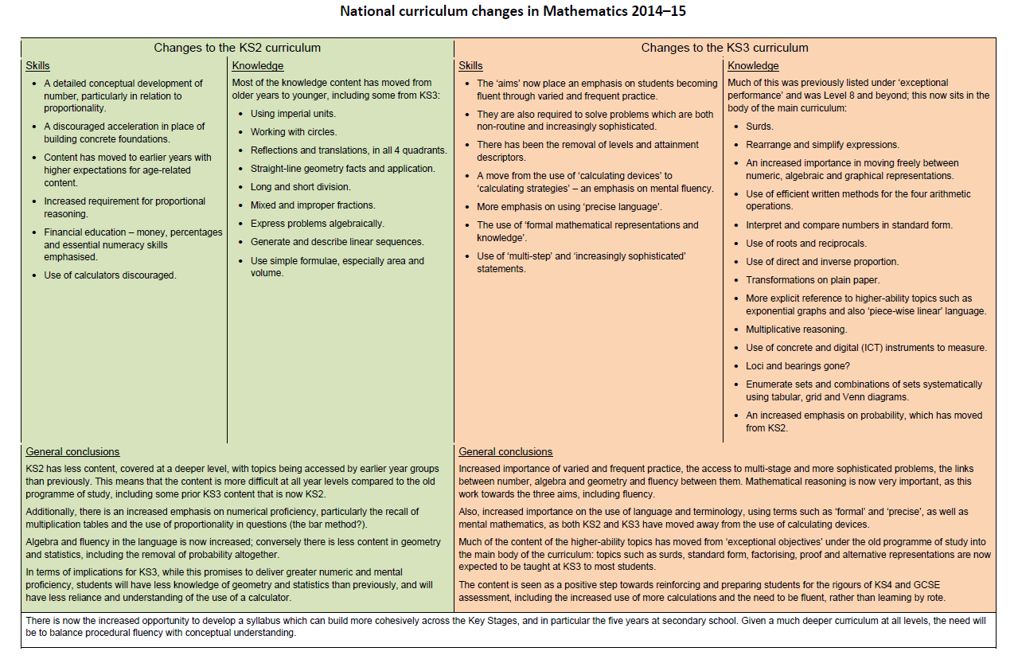
National Curriculum Changes 1

Slide 36
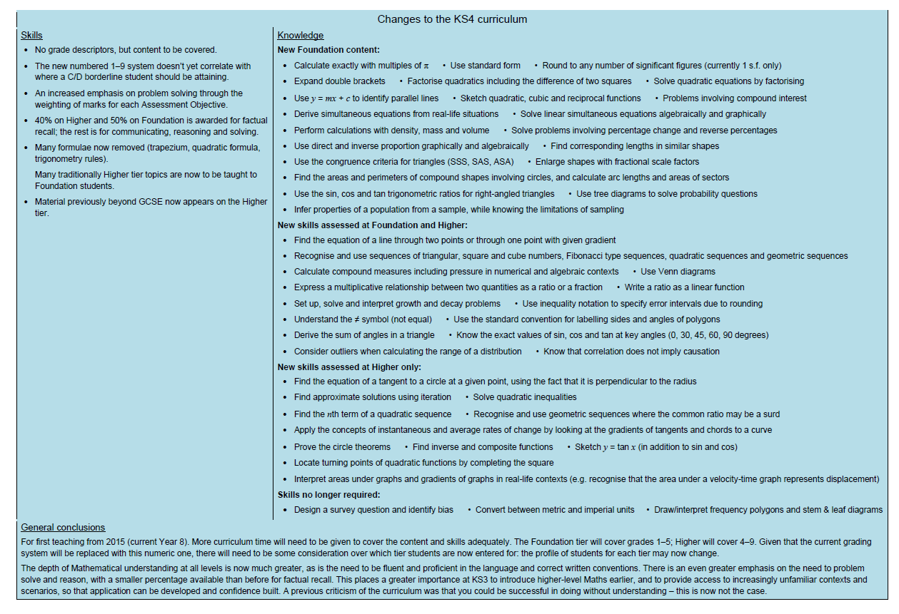
National Curriculum Changes 2

Slide 37
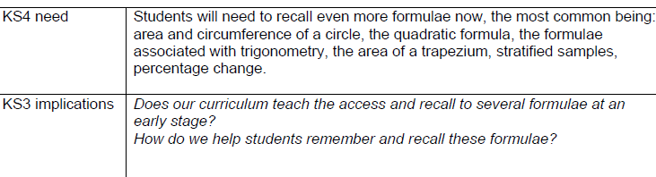
Preparing for the new GCSE 1

Slide 38
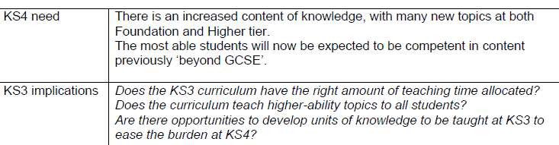
Preparing for the new GCSE 2

Slide 39
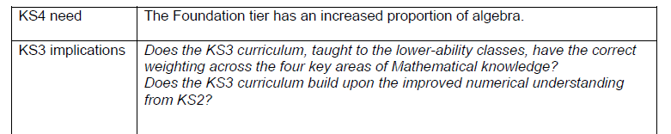
Preparing for the new GCSE 3

Slide 40
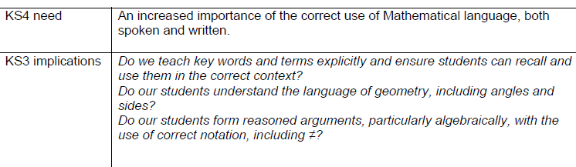
Preparing for the new GCSE 4

Slide 41
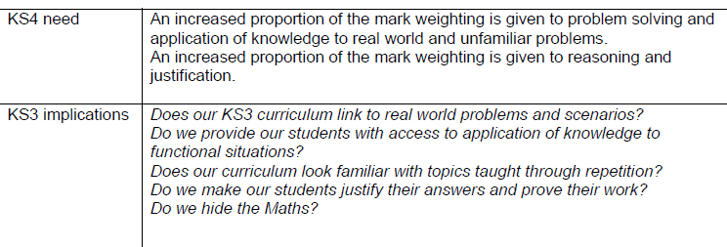
Preparing for the new GCSE 5

Slide 42
Expand
(X + 3)(X + 2)
(X -3)(X - 2)

Slide 43
(X + 3)(X + 2) = X(X + 2) + 3(X +2)
= (X +2)xX + (X + 2)x3
=(XxX+2xX) + (3xX+3x2)
= X² +5X + 6
(X -3)(X - 2) = Xx(X - 2) – 3x(X -2)
= (X -2)xX - (X – 2)x3
=(XxX-2xX)-(3xX-2x3)
= X² -5X + 6
How does a binary operation suddenly become a unitary operation?

Slide 44
Can you explain …
(x + 3) (x + 2)
(x + 3) (x – 2)
(x – 3) (x – 2)
Can you use diagrams

Slide 45
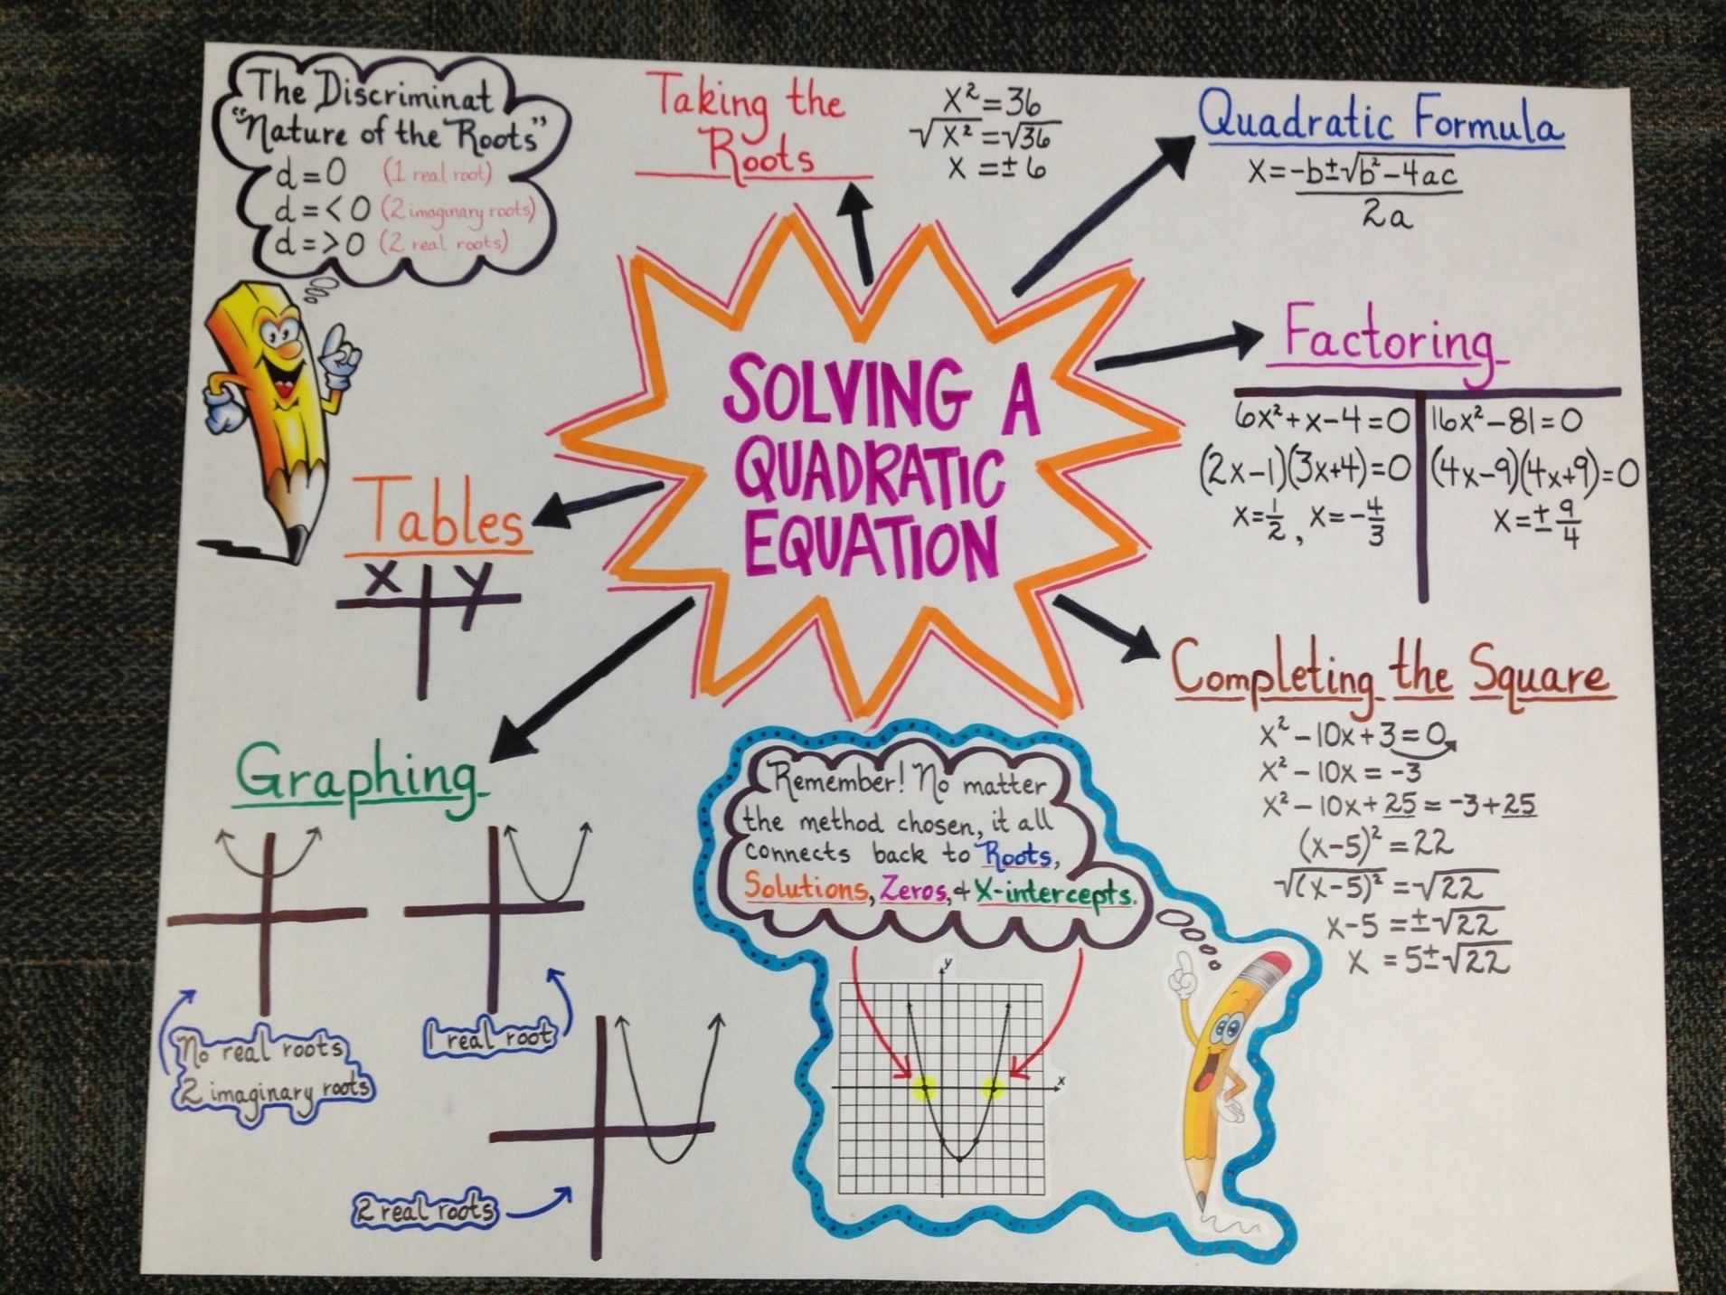

Slide 46
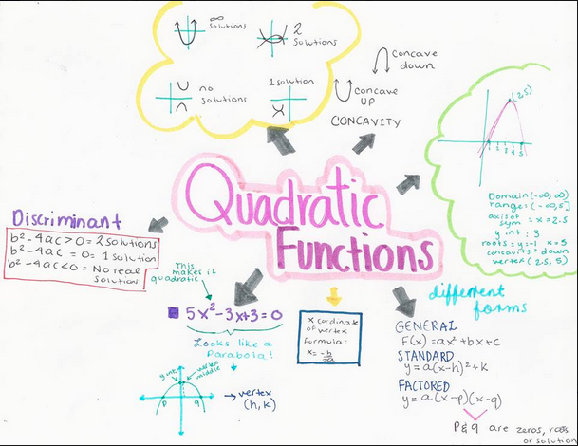

Slide 47
GCSE Questions on Quadratics
AQA Higher Paper 1 2017

Slide 48
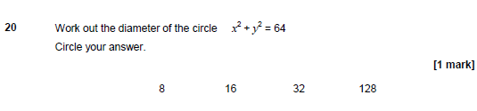
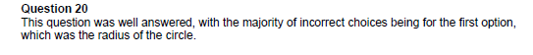

Slide 49
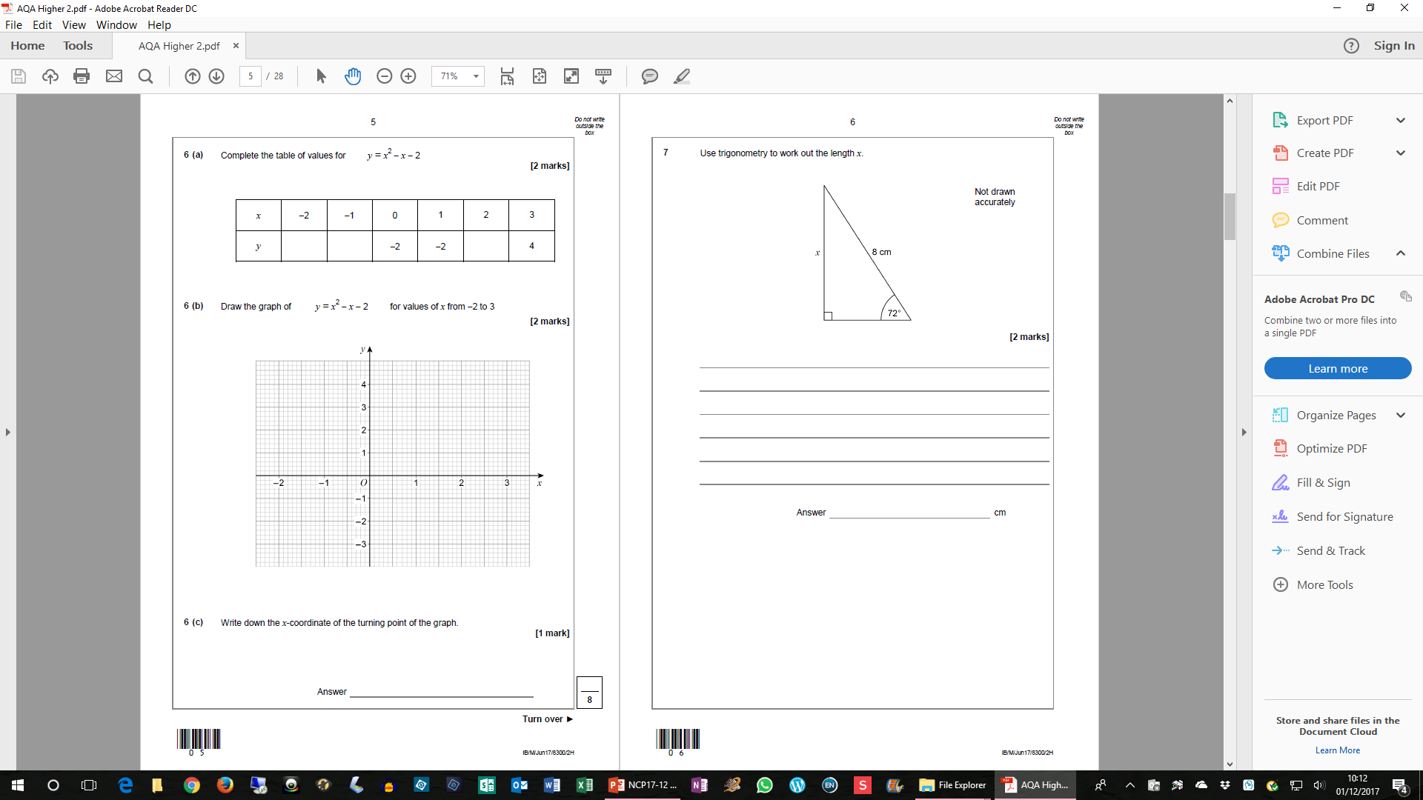
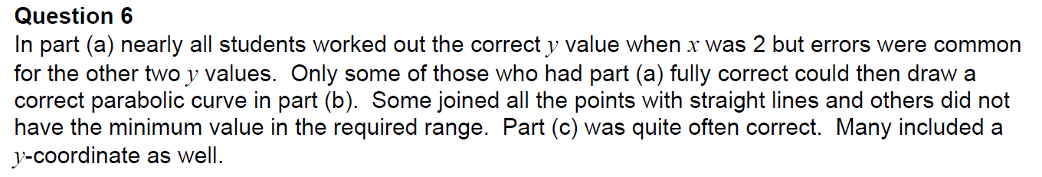
AQA Higher Paper 2 2017

Slide 50
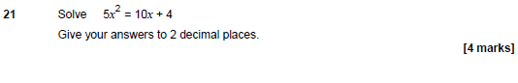
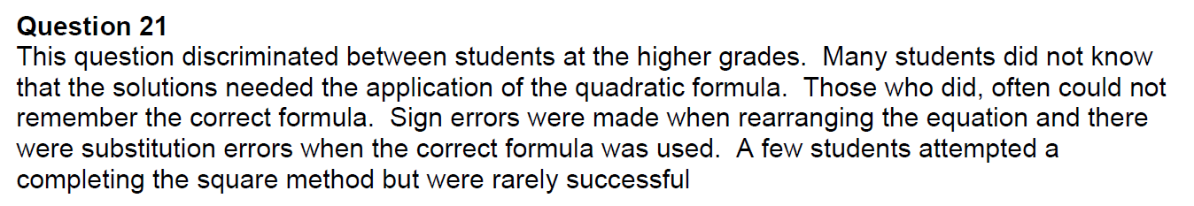

Slide 51
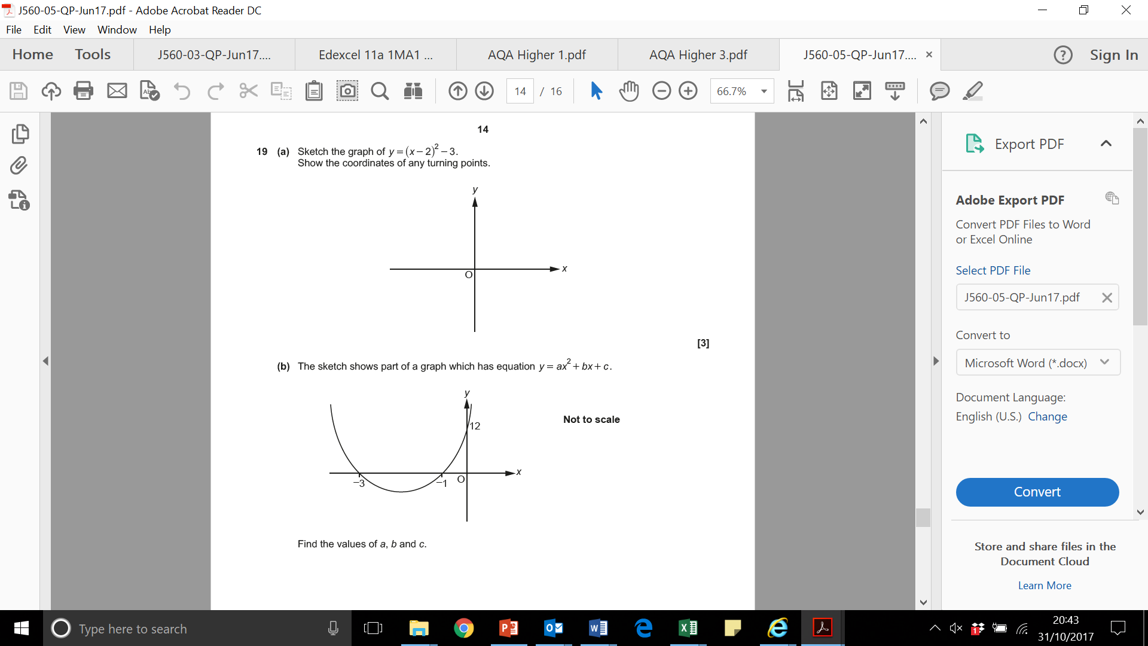
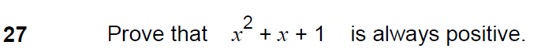
Three more…

Slide 52
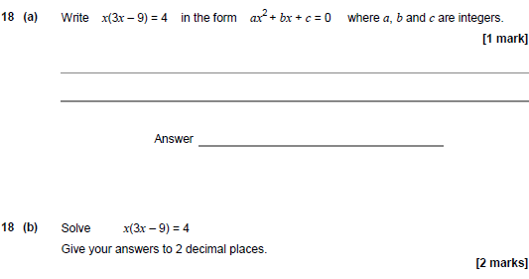
AQA Paper 3
2019

Slide 53
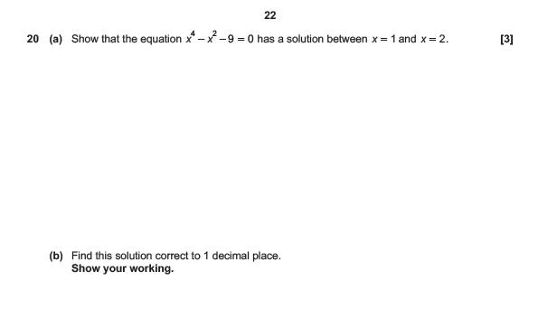
OCR Paper 6
2019

Slide 54
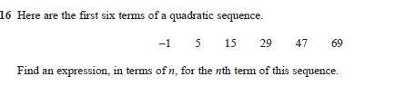
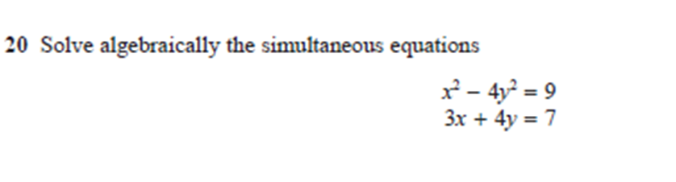
Edexcel Paper 6
2019

Slide 55
Looking at GCSE papers
On your table are a collection of a previous year’s GCSE questions on quadratics.
What makes each of these a challenging question?
Where would students make errors and why?
What aspects would you expect pupils to struggle with?
Why would students find these questions challenging?
How might we prepare in future?

Slide 56
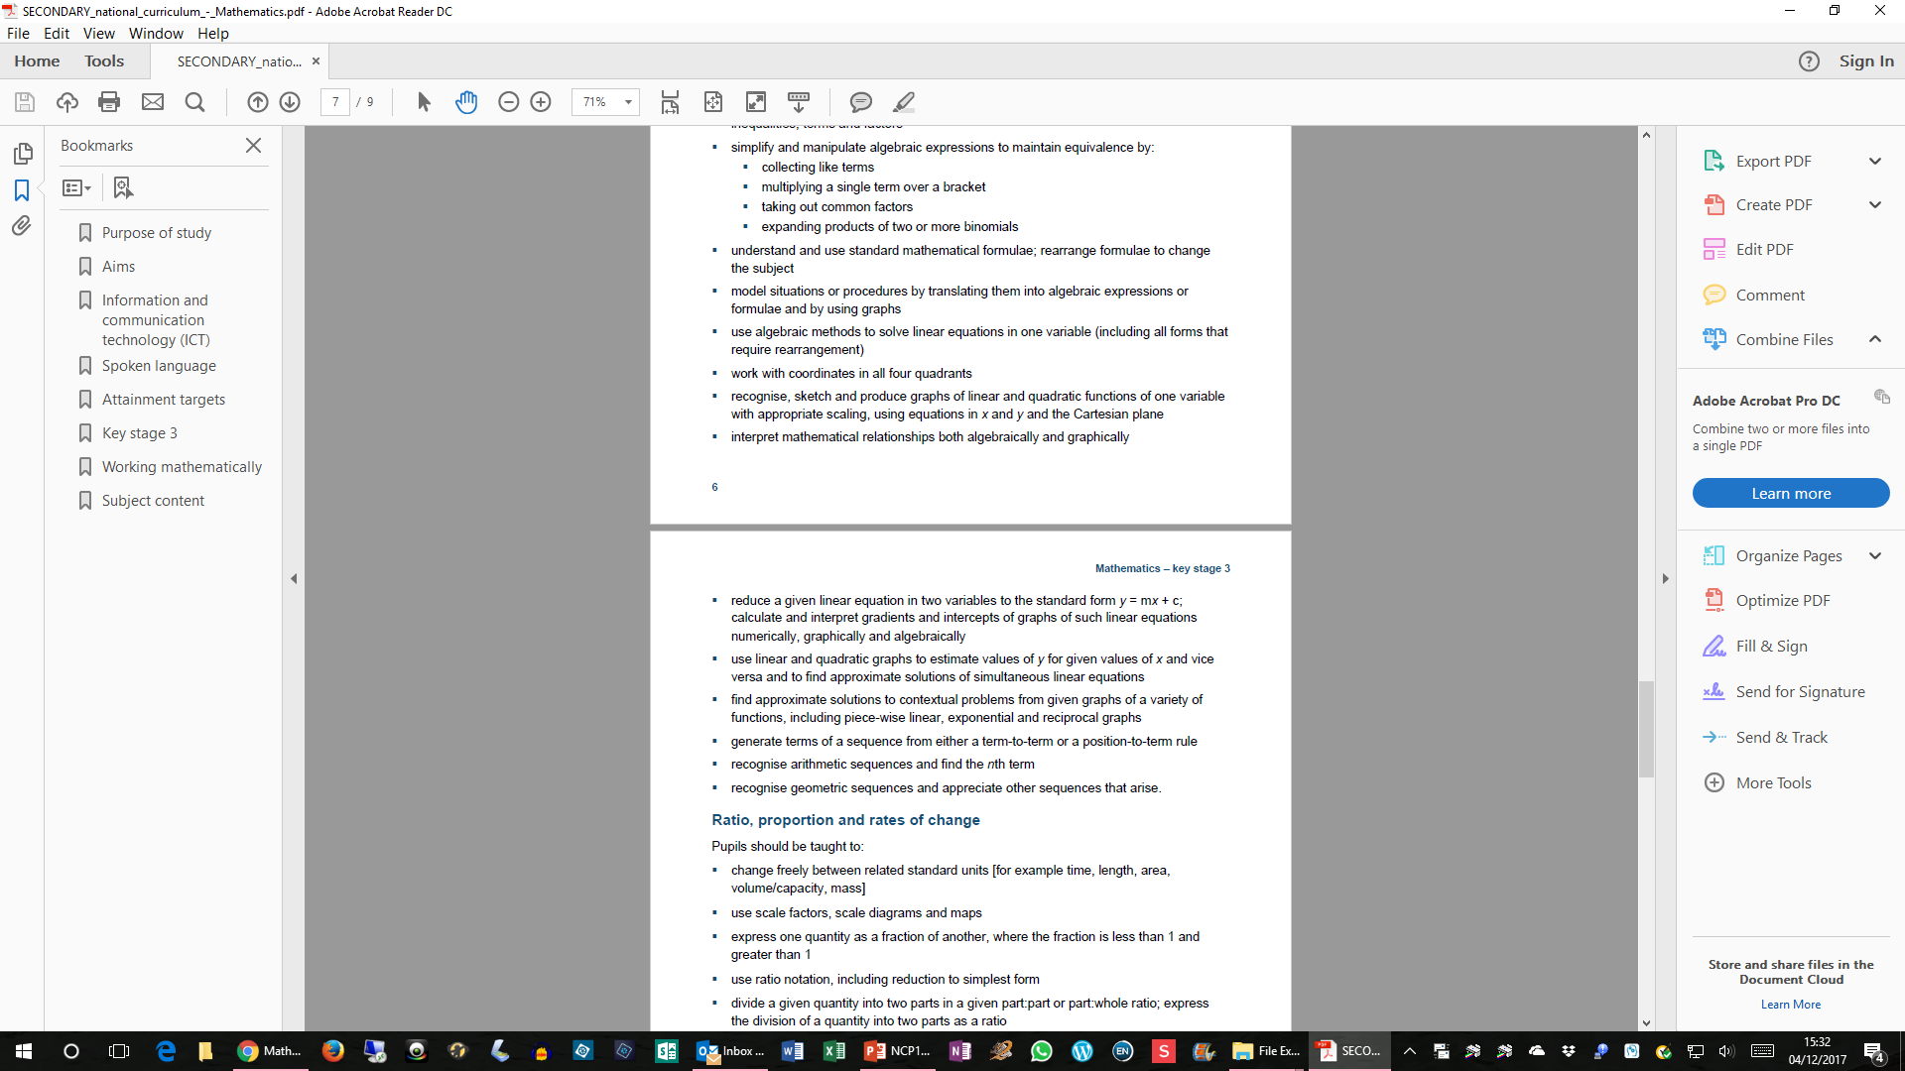
National Curriculum KS3

Slide 57
National Curriculum KS3

Slide 58
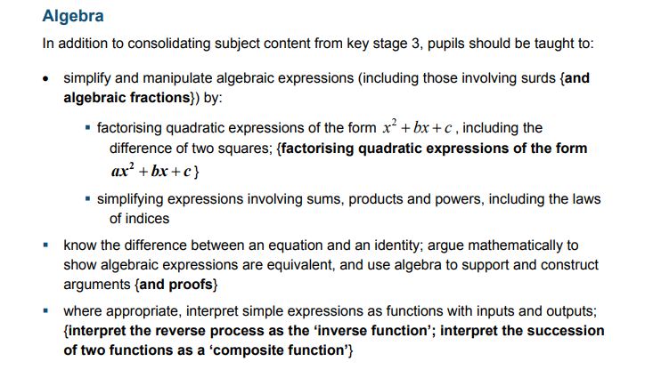
National Curriculum KS4

Slide 59
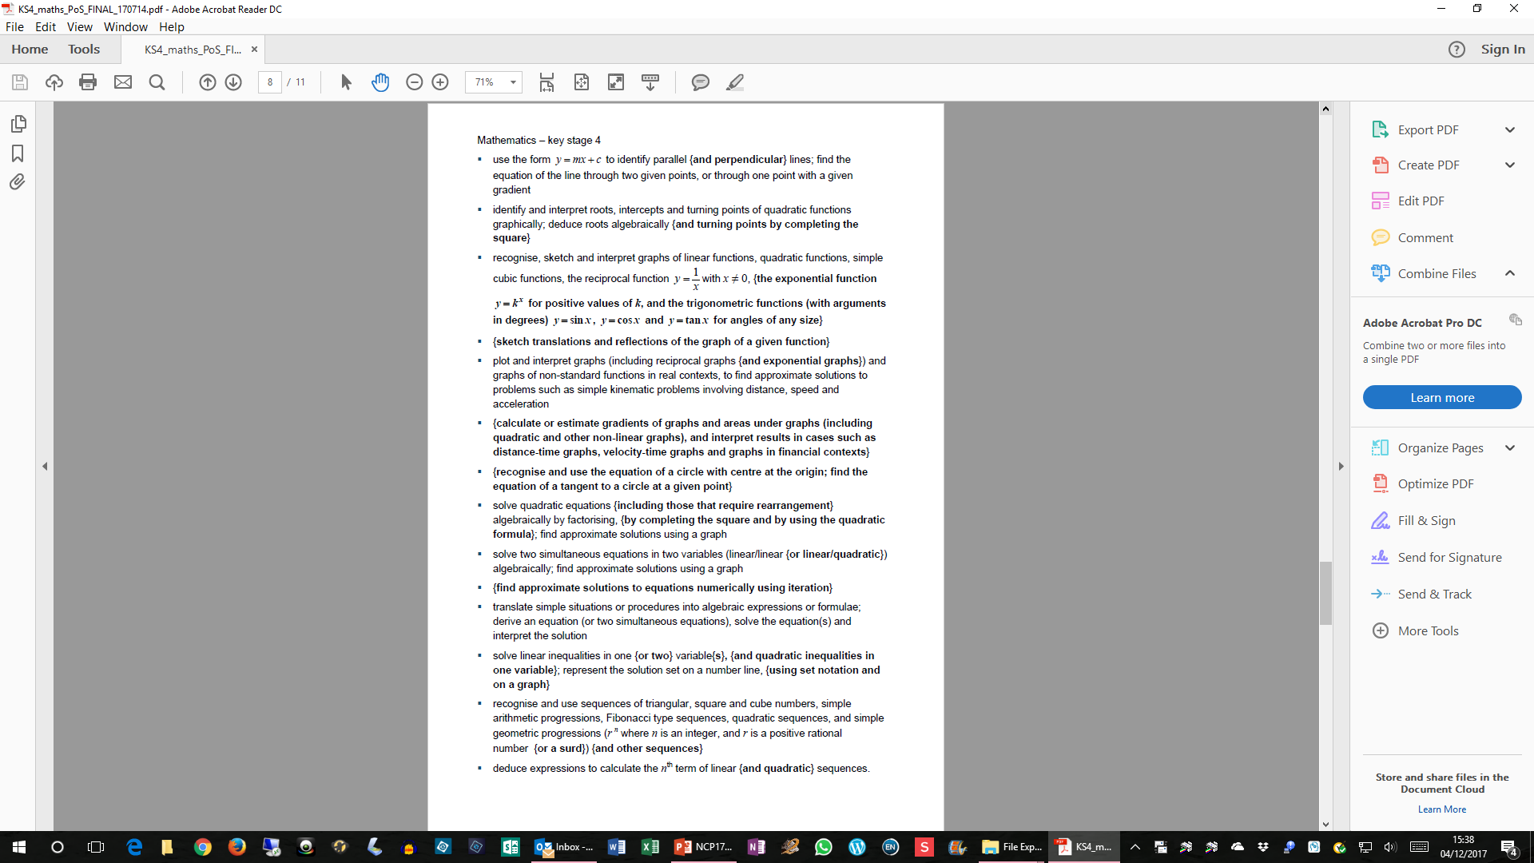
National Curriculum KS4

Slide 60
National Curriculum KS4

Slide 61
Topic Map
What are the fundamental “blocks” of ideas?
How do these connect together?
What are the pre-requisites?
Are there any logical orderings?
Try to build up a complex web of concepts and techniques.

Slide 62
“Preparing a Topic” framework
What do we need to know?
Key mathematics
What are the key mathematical “big” ideas in the topic
Misconceptions and errors
What common errors do pupils make in this topic and why?
Language and vocabulary
What sort of language and technical vocabulary is used
Techniques and methods
What sort of things do you do in this topic
Topic
Imagery and visualisation
What images, pictures, diagrams are involved?
Contexts and settings
Where is this topic used? What sorts of questions?
What do we now know?

Slide 63
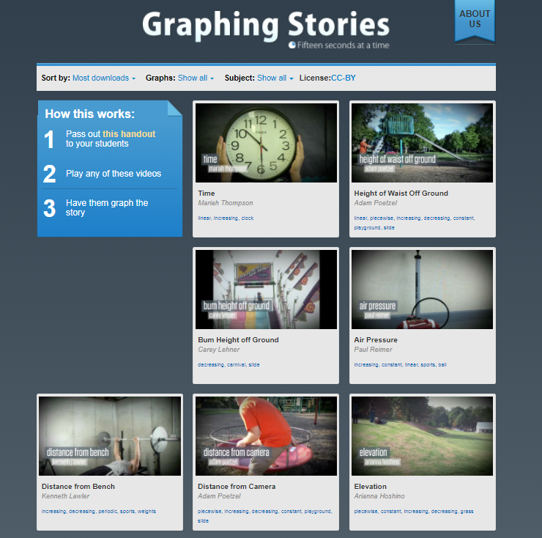
Some interesting Resources?
Graphing Stories
http://www.graphingstories.com/
Resourceaholic
http://www.resourceaholic.com/p/resource-library-key-stage-34-algebra.html#Area
Graphing
https://www.desmos.com/calculator

Slide 64
From linear to quadratic…
Use Desmos…
  Plot y₁ = x+3
  Plot y₂ = x-2
  Plot y₁ ₊ y₂
  Plot y₁ ₋ y₂
  Plot y_{1 x} y₂
  Plot y_{1 /} y₂
Vary y₁ and y_{2.} What do you notice?

Slide 65
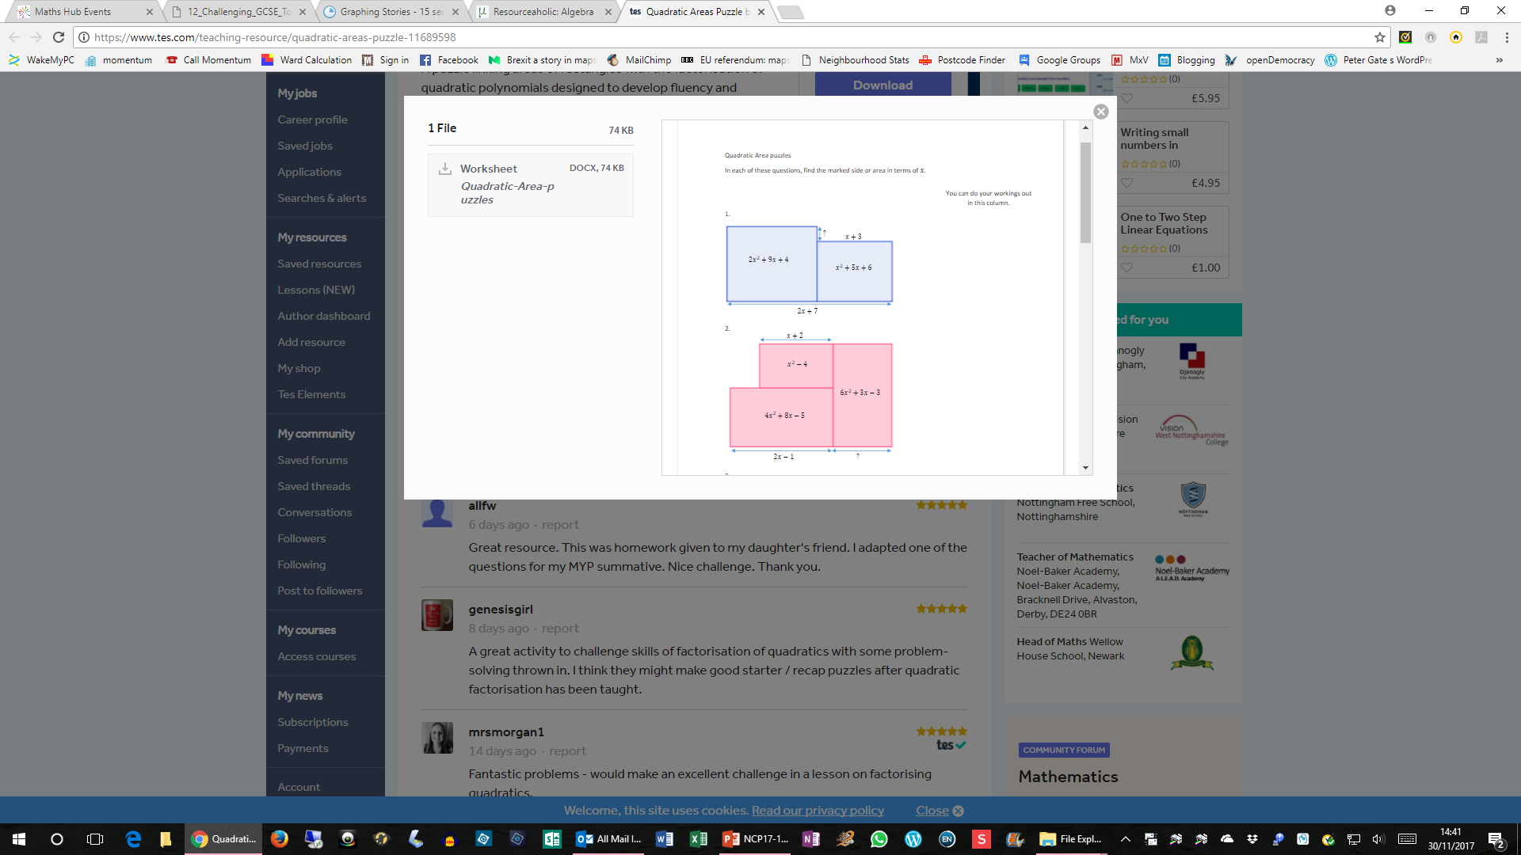
Quadratic Area Puzzles
In each question find the marked side or area in terms of x

Slide 66
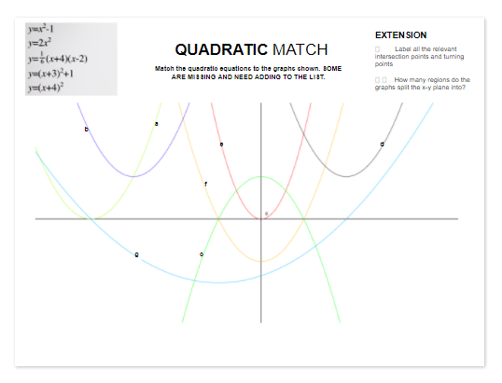

Slide 67
Quadratic Sequences
U_{n} = an² + bn + c
Why is a = 2 x d₂

Slide 68
Evaluation questions
Has there been a contribution to our subject and pedagogical knowledge?
Were there any changes to our practice through participation in the Work Group and if so how can this be sustained?
What was the effect of the Work Group on pupil attainment, progress and attitude?

